Slide 1
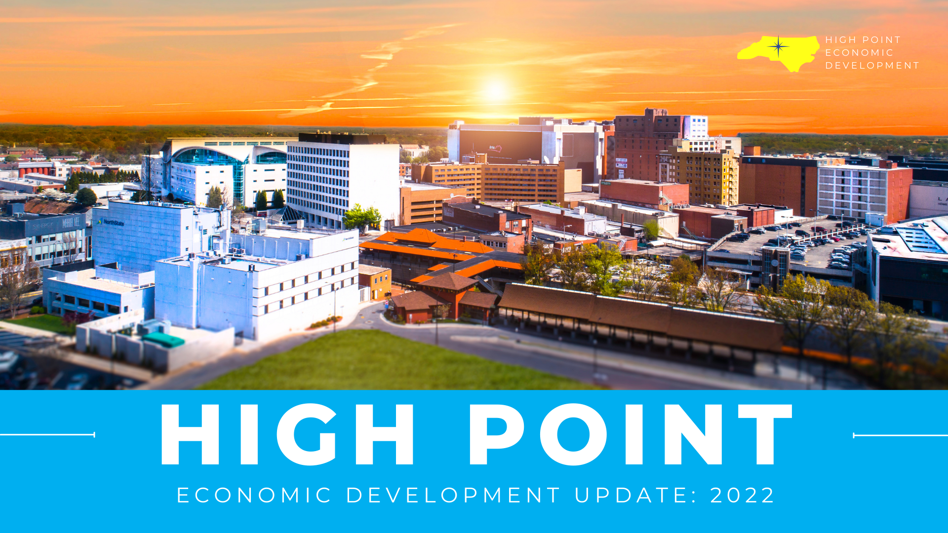

Slide 2
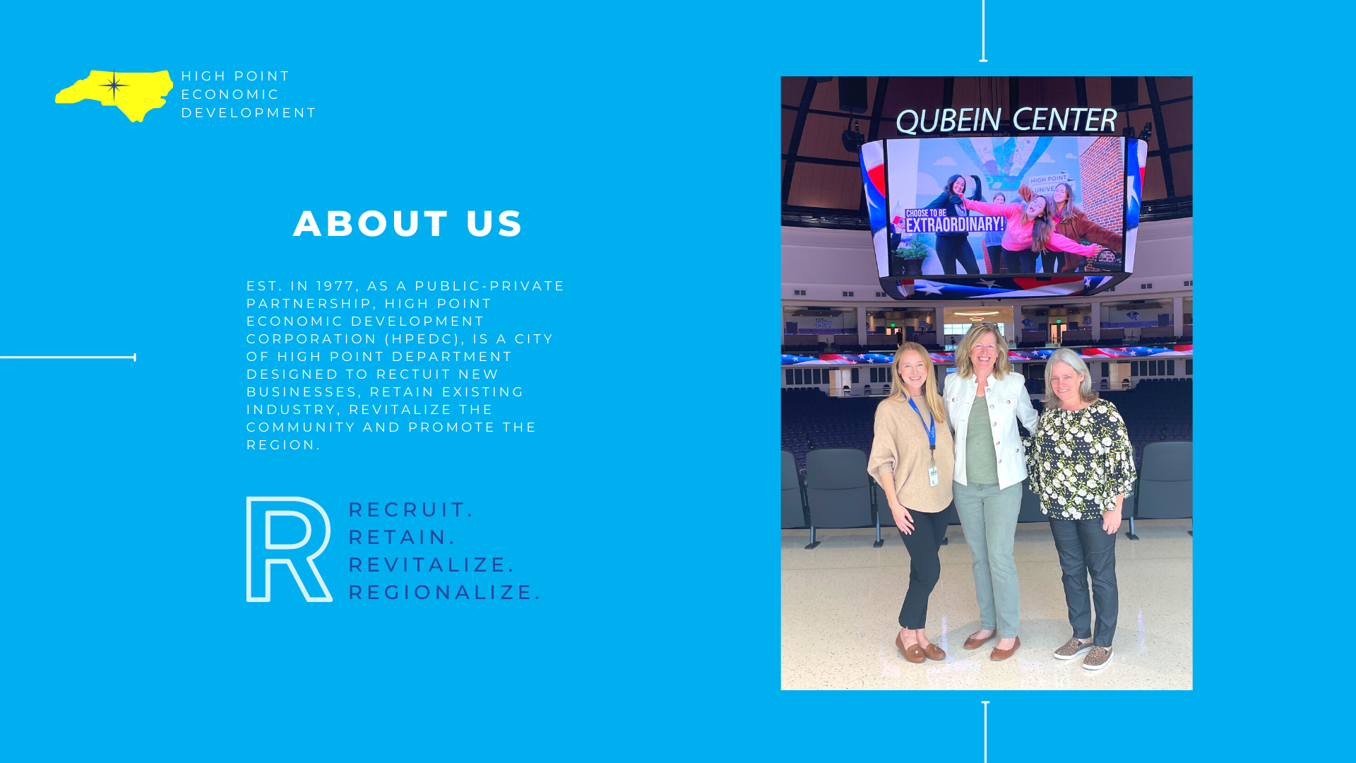

Slide 3


Slide 4
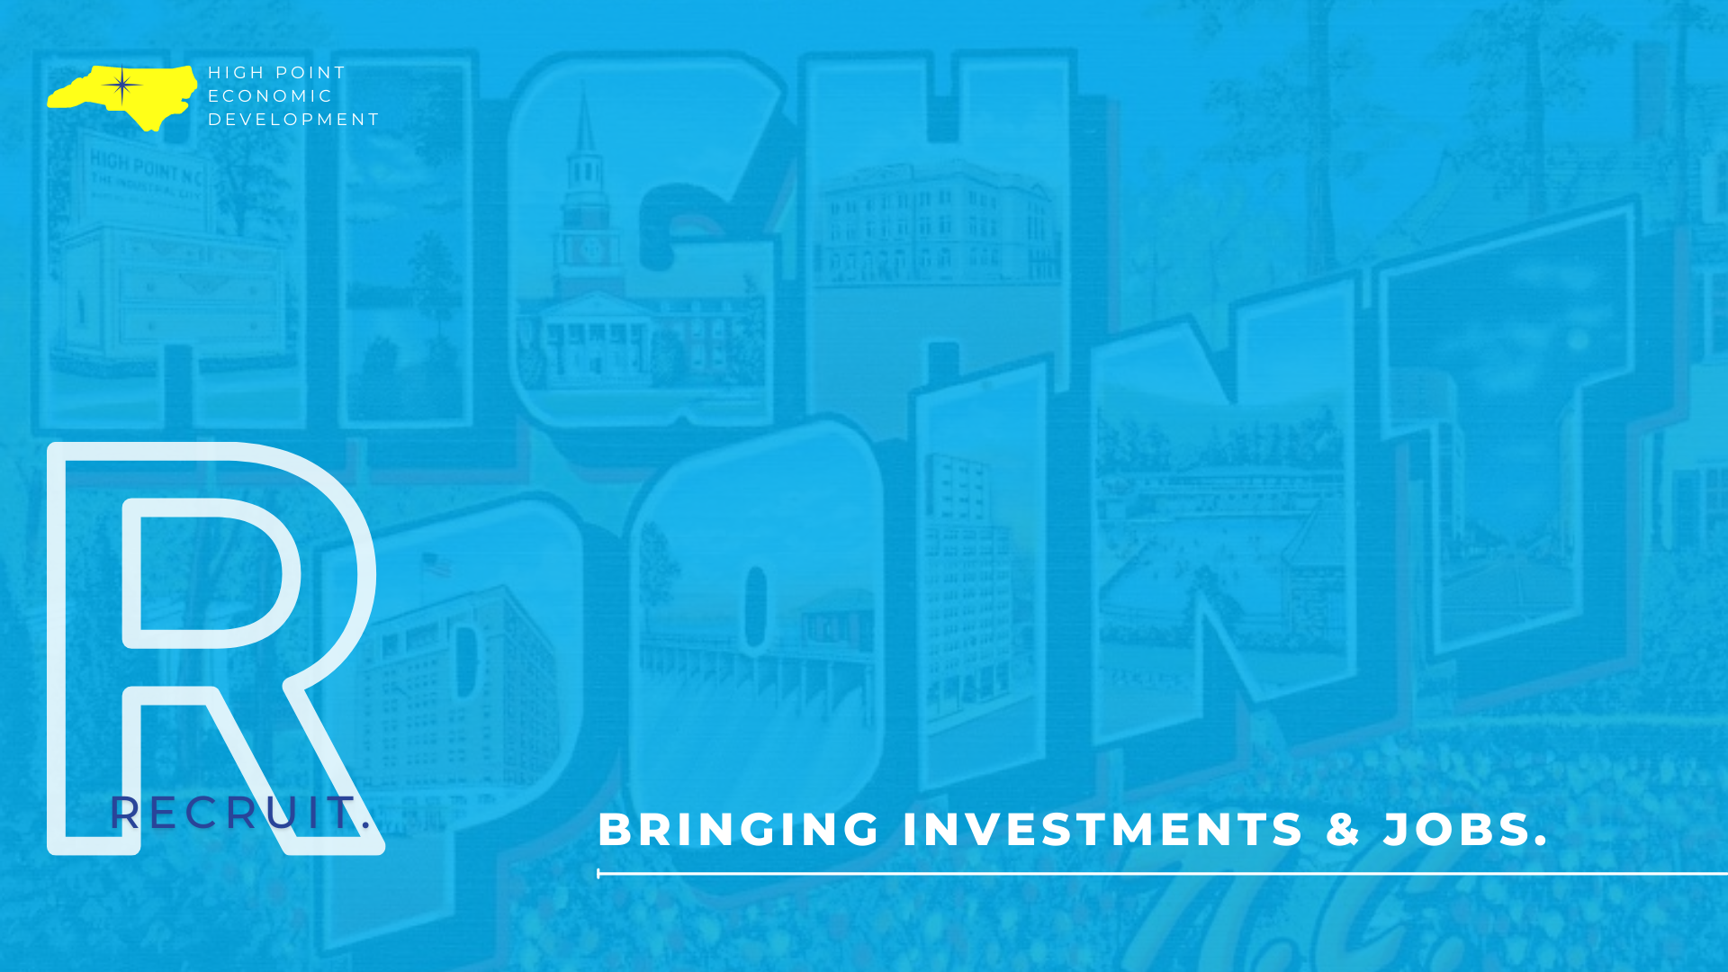

Slide 5
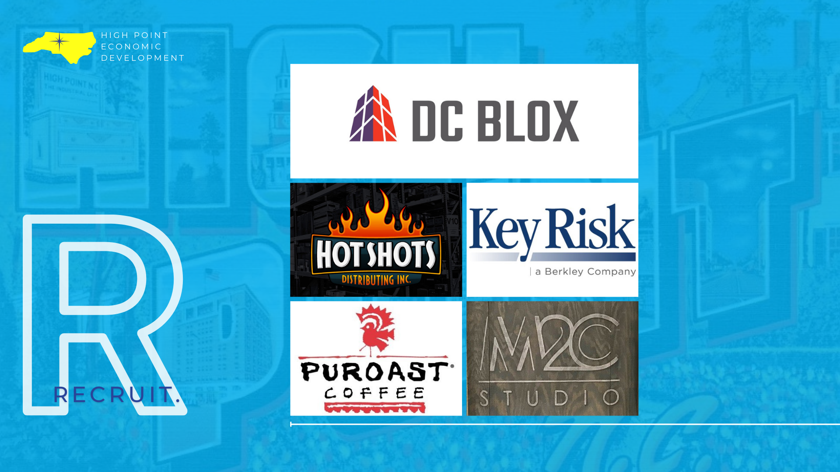

Slide 6
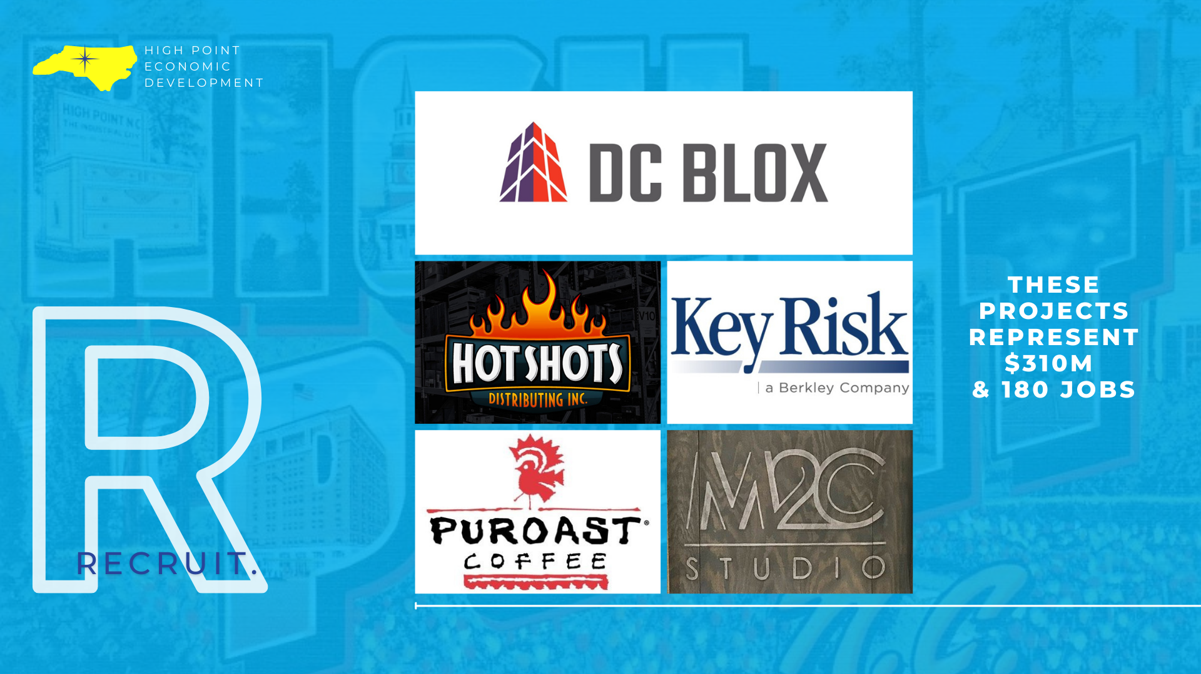

Slide 7
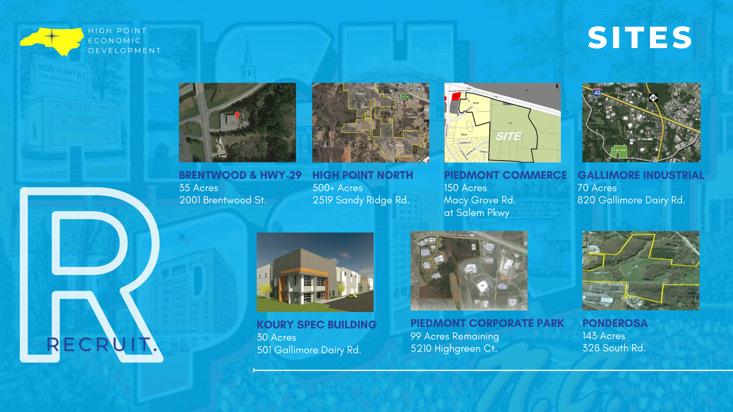

Slide 8
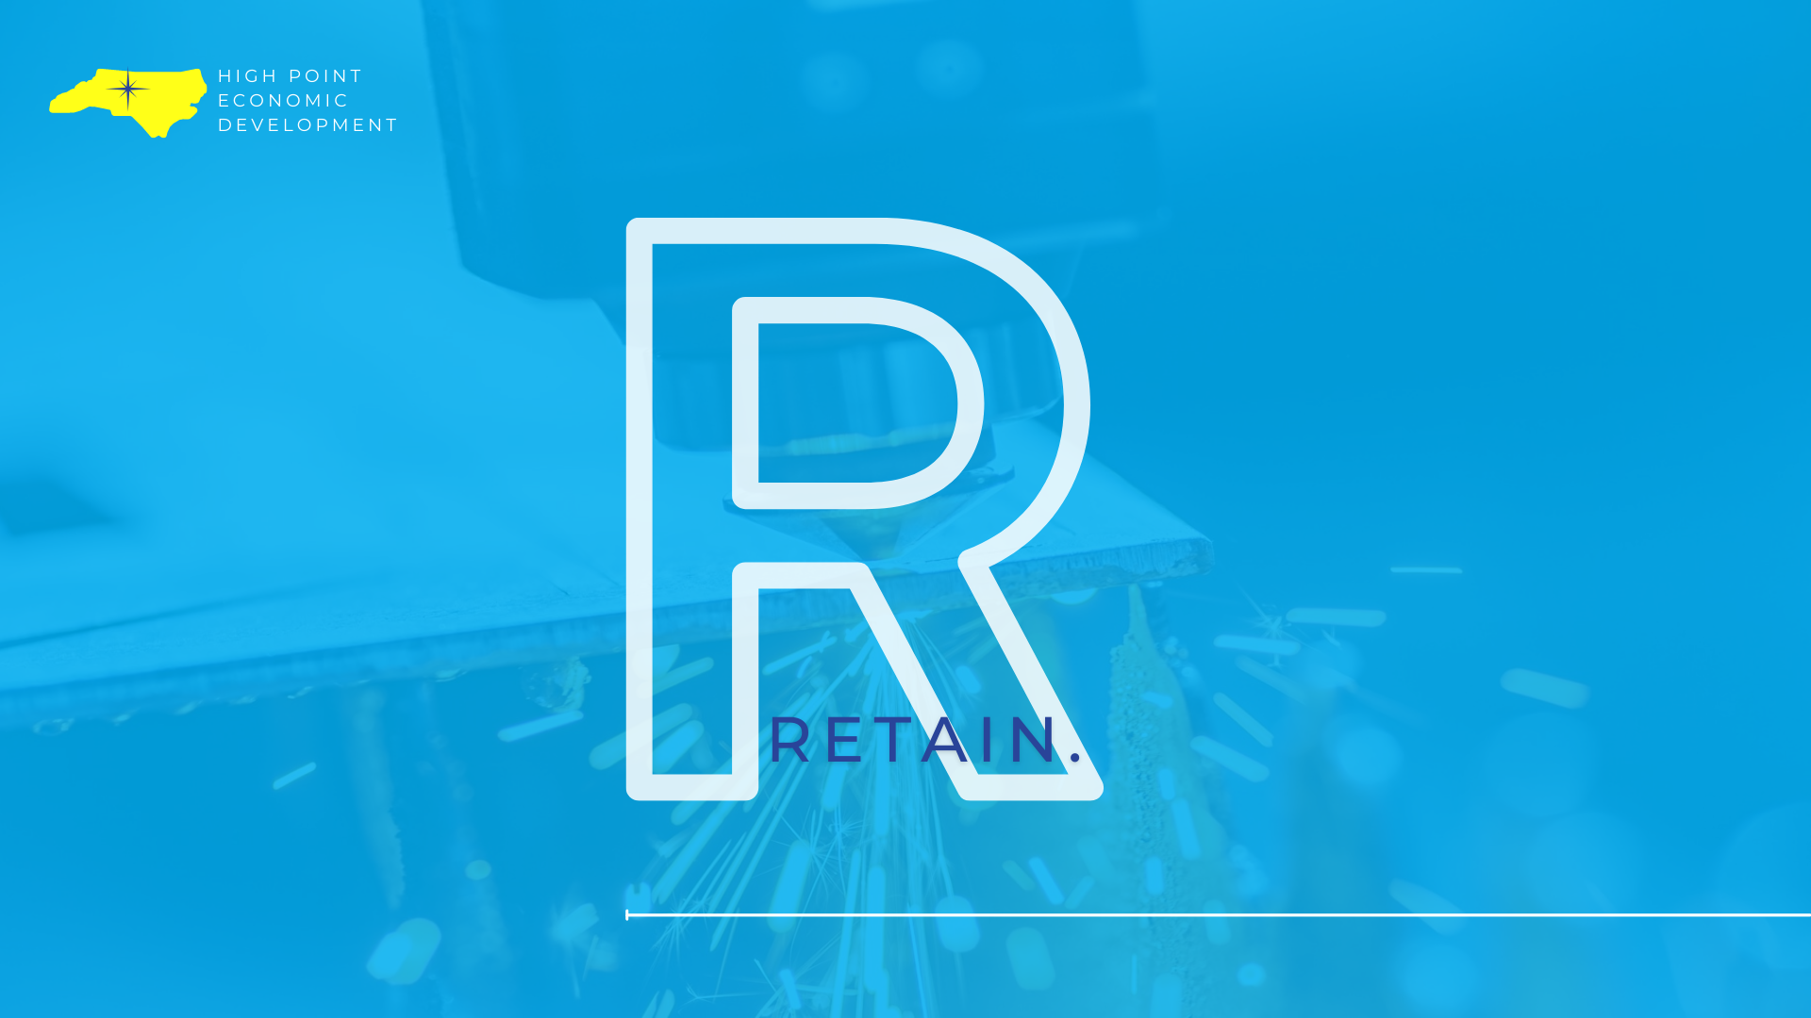

Slide 9
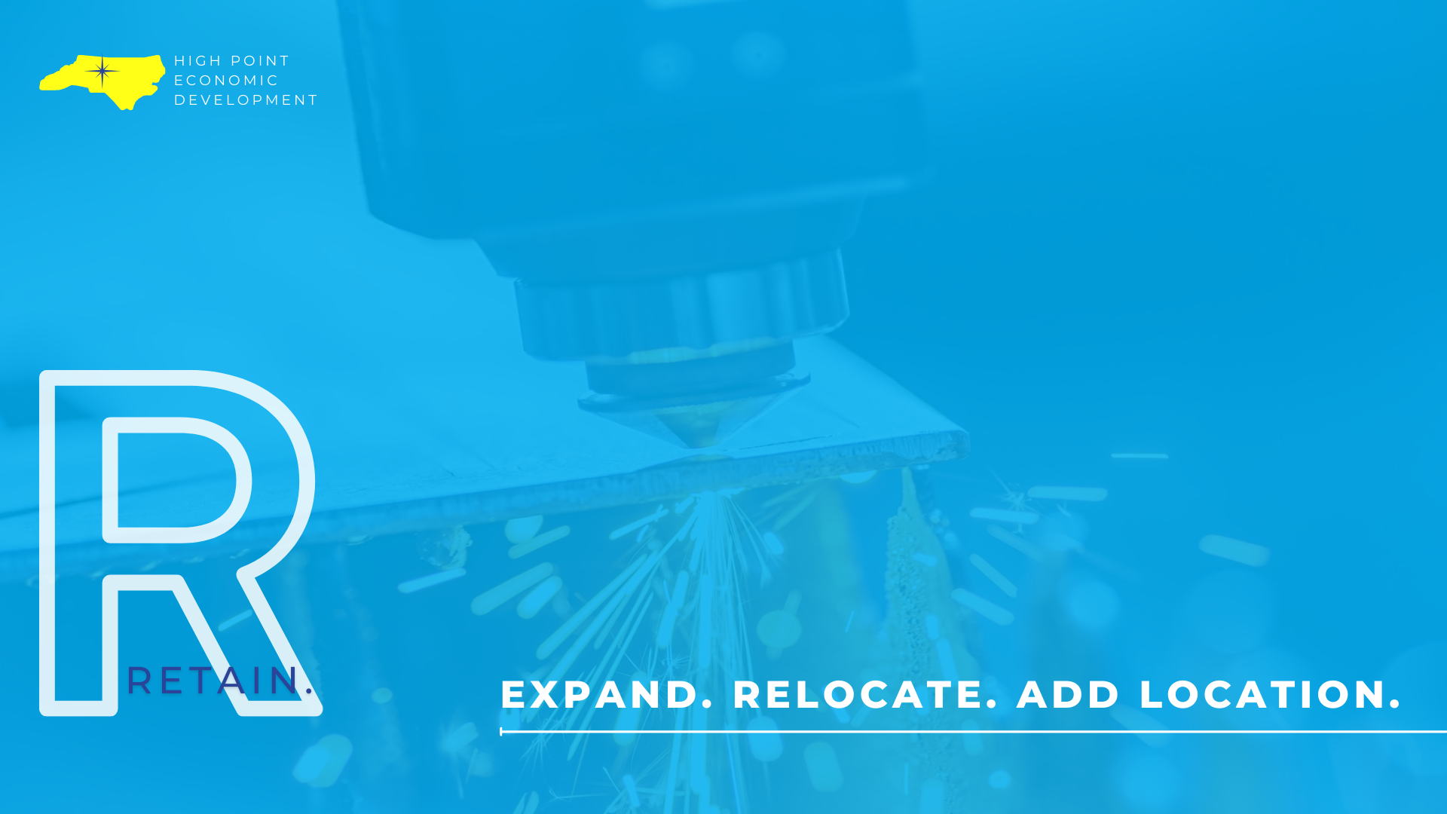

Slide 10
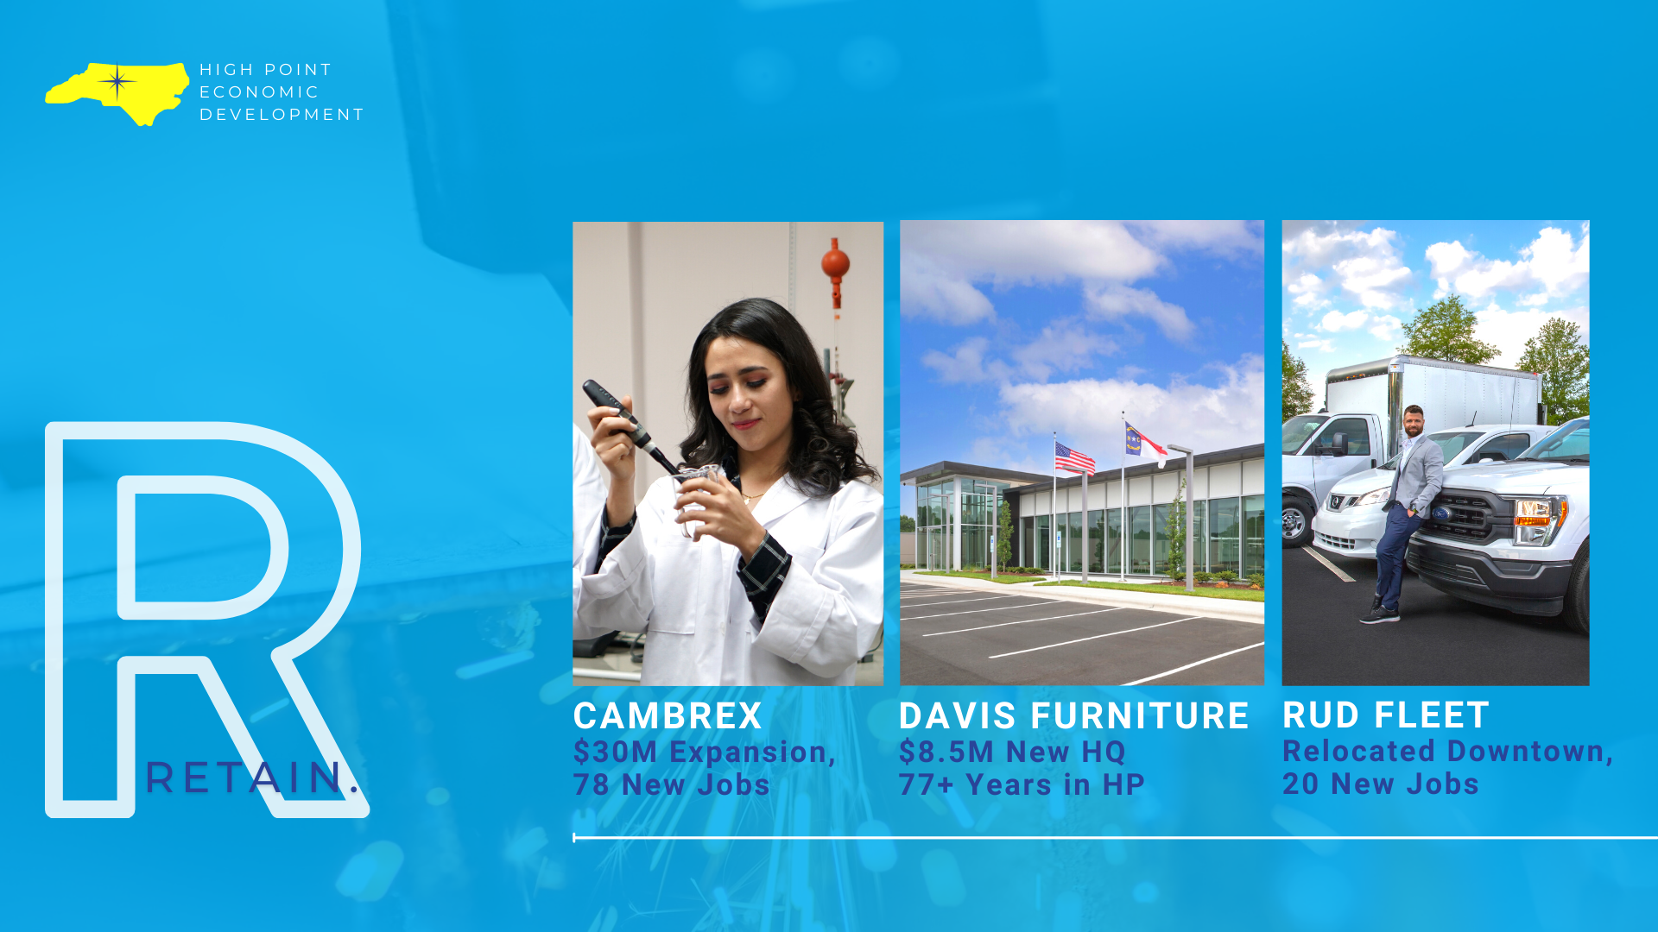

Slide 11


Slide 12


Slide 13
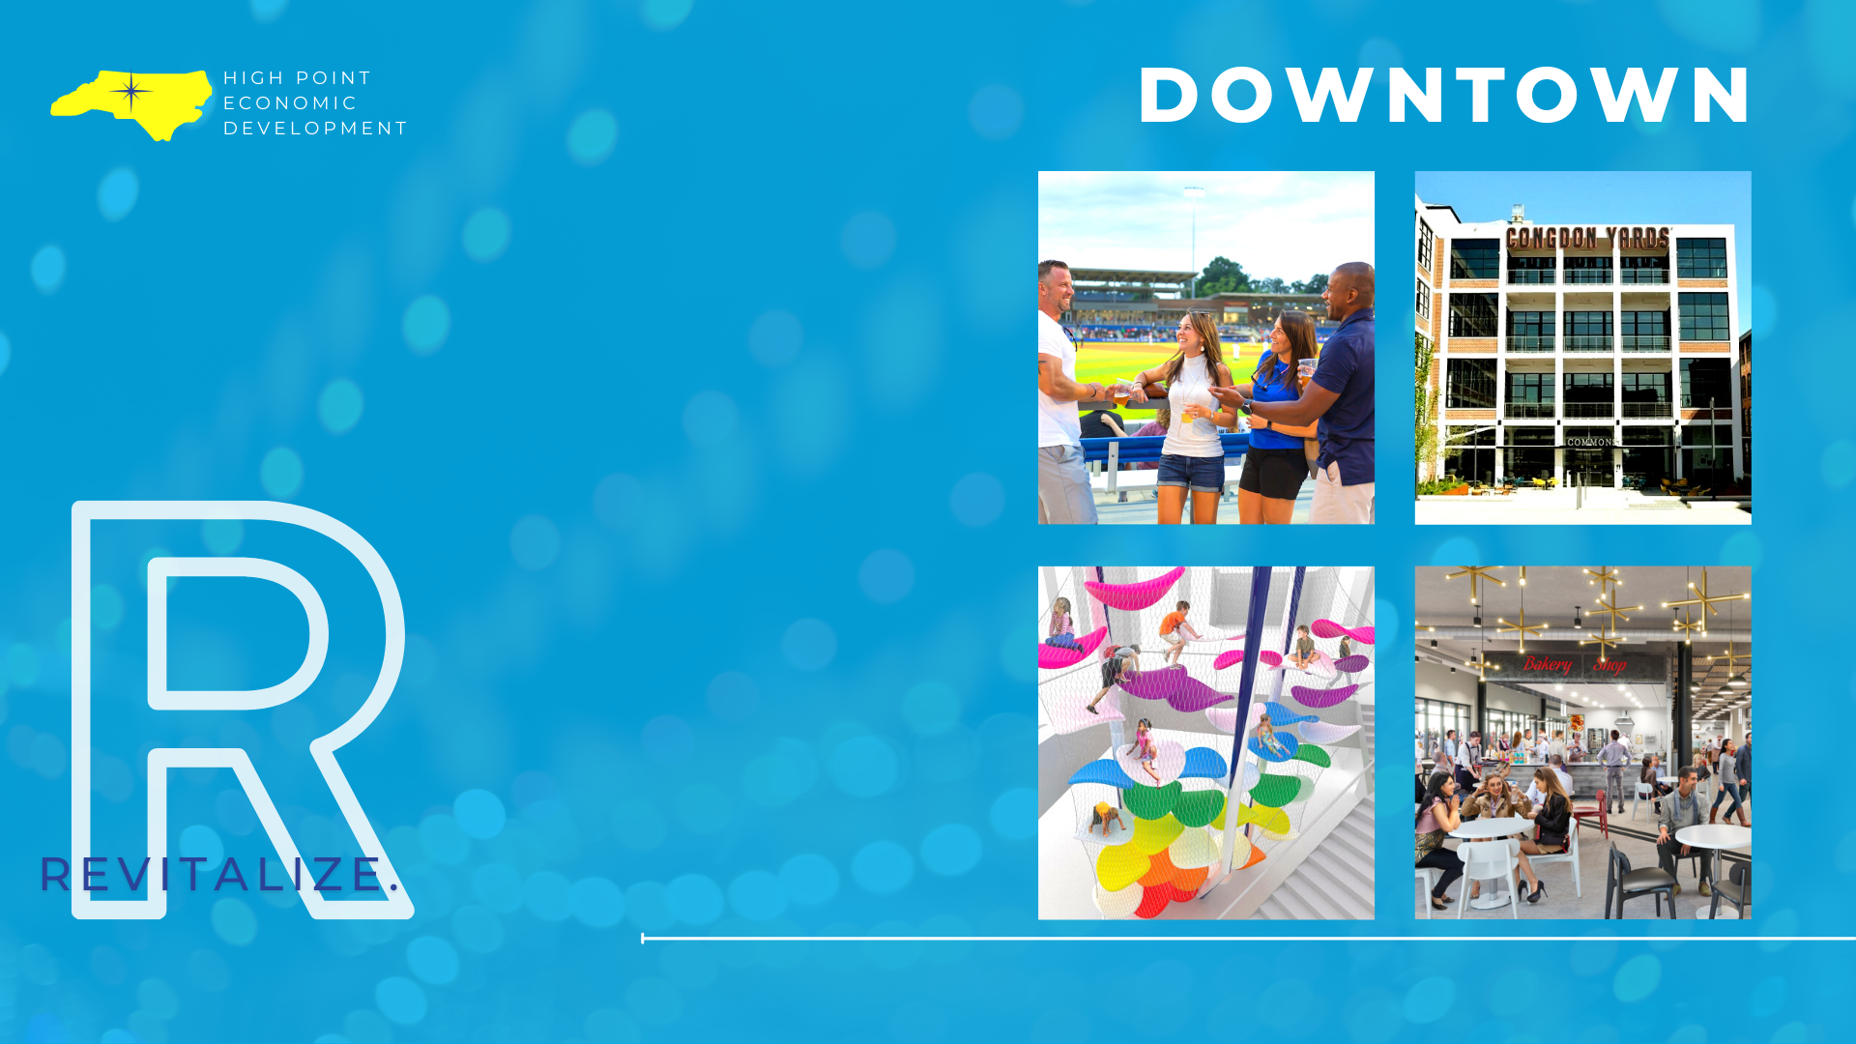

Slide 14
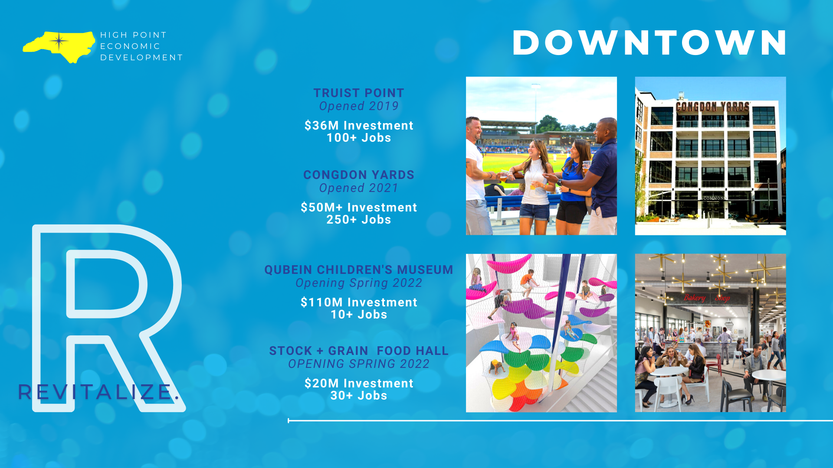

Slide 15
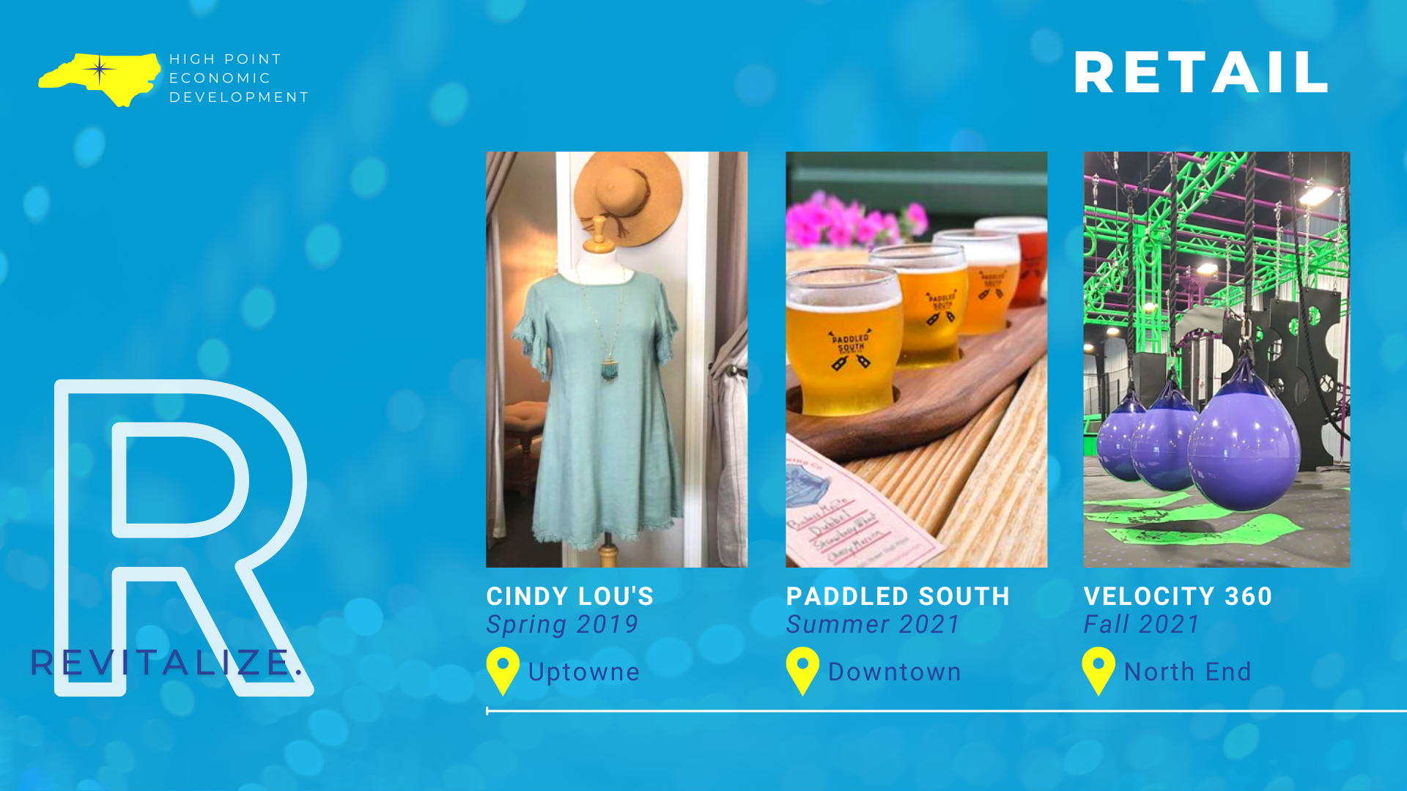

Slide 16
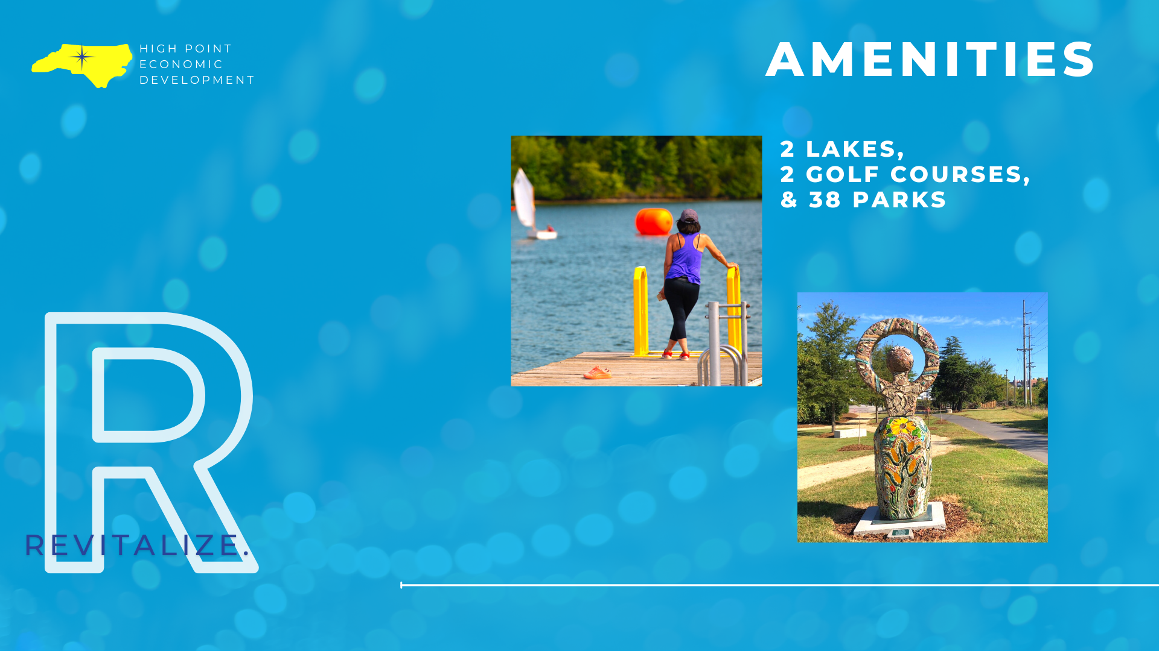

Slide 17
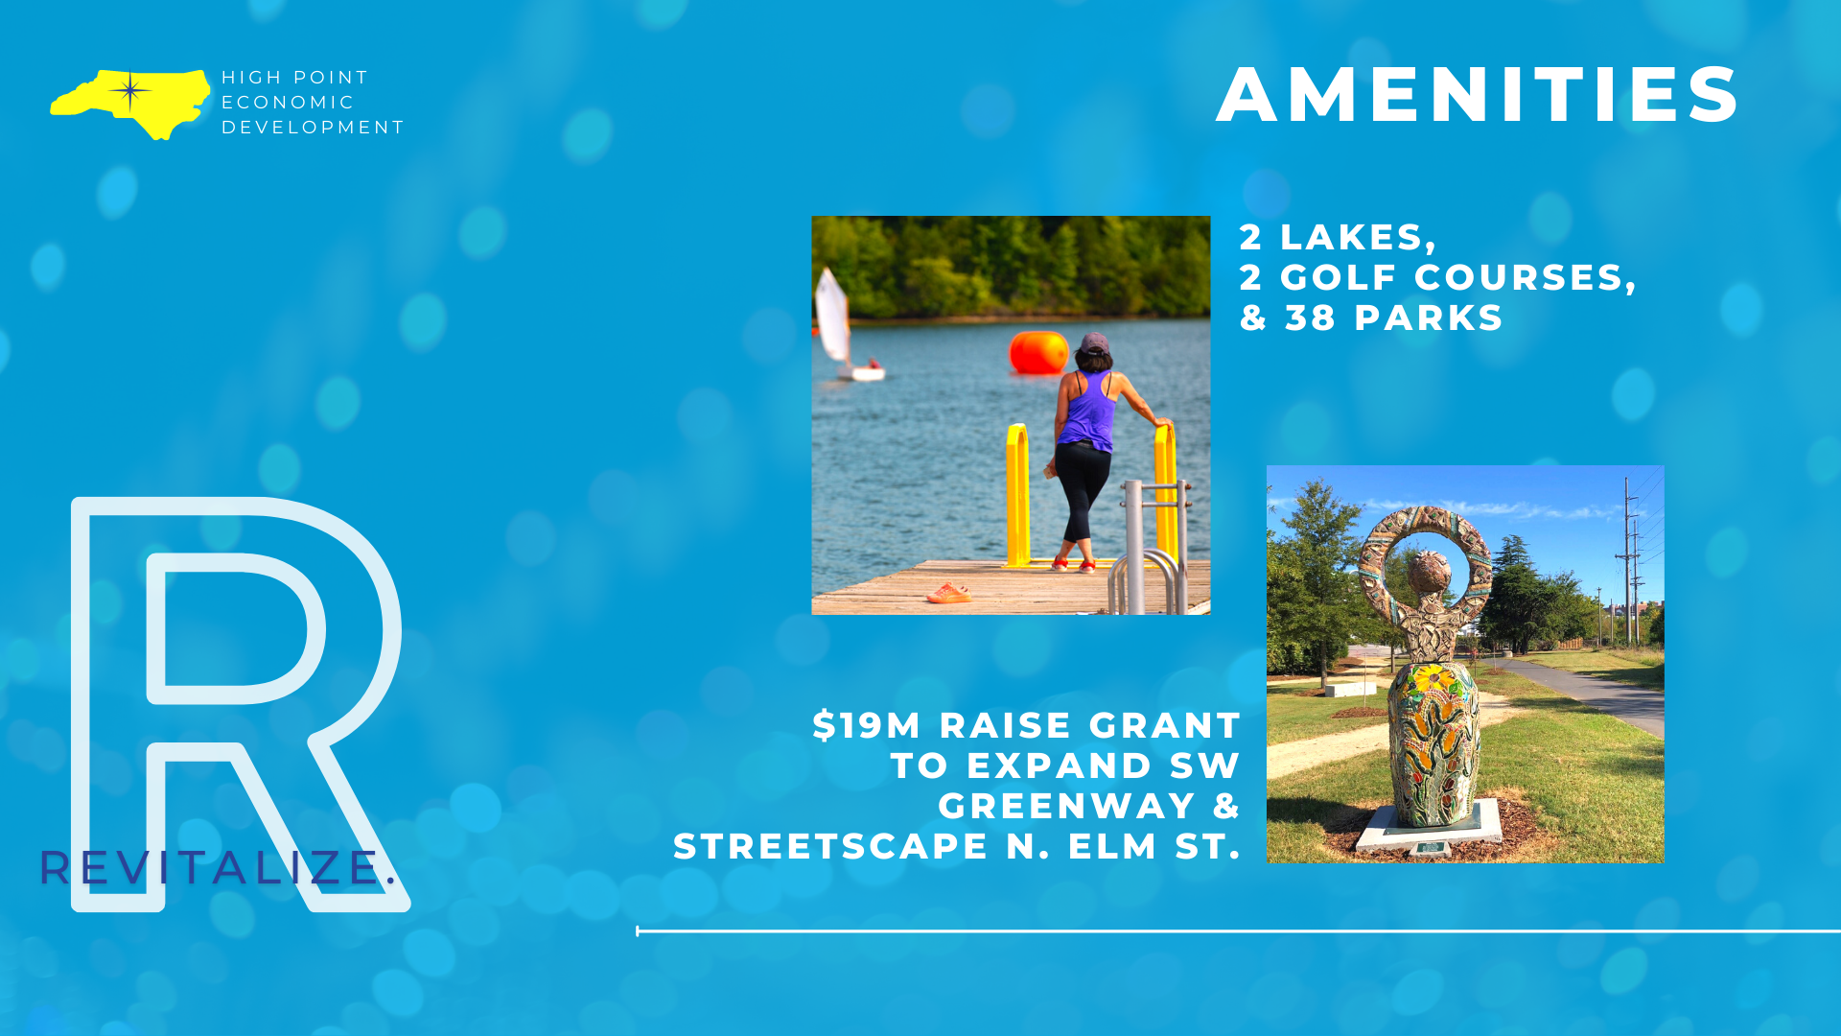

Slide 18
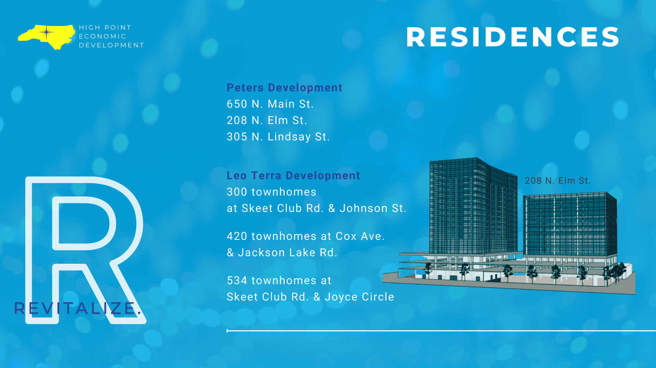

Slide 19
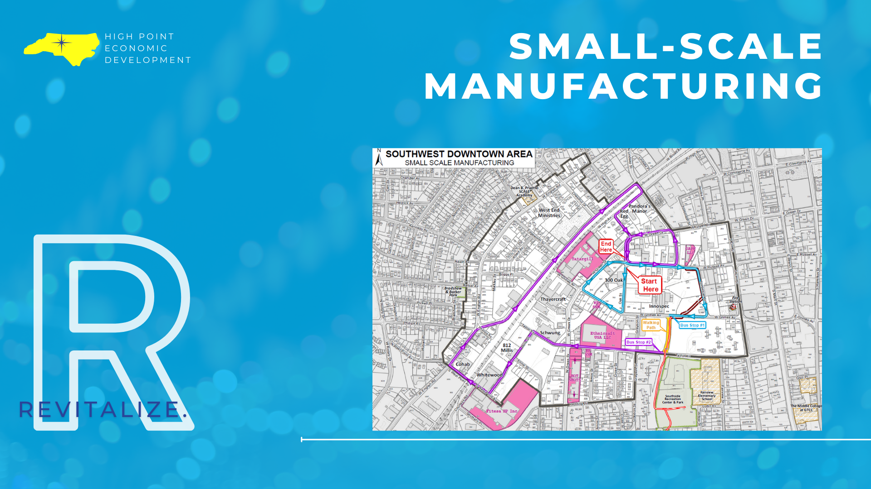

Slide 20
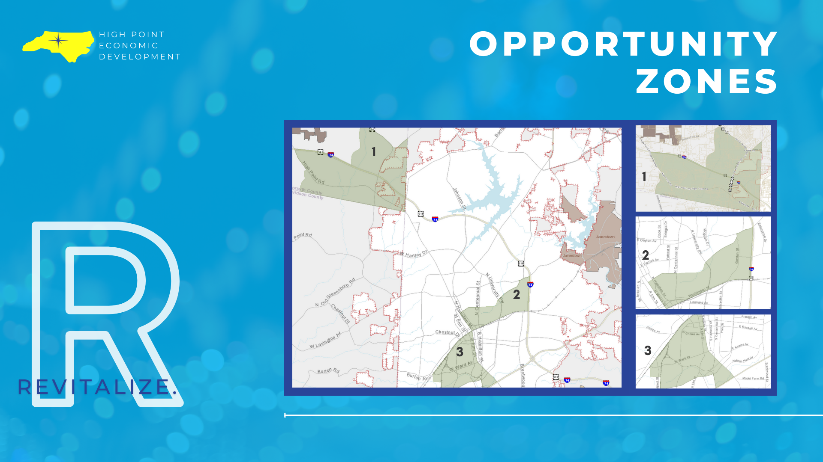

Slide 21
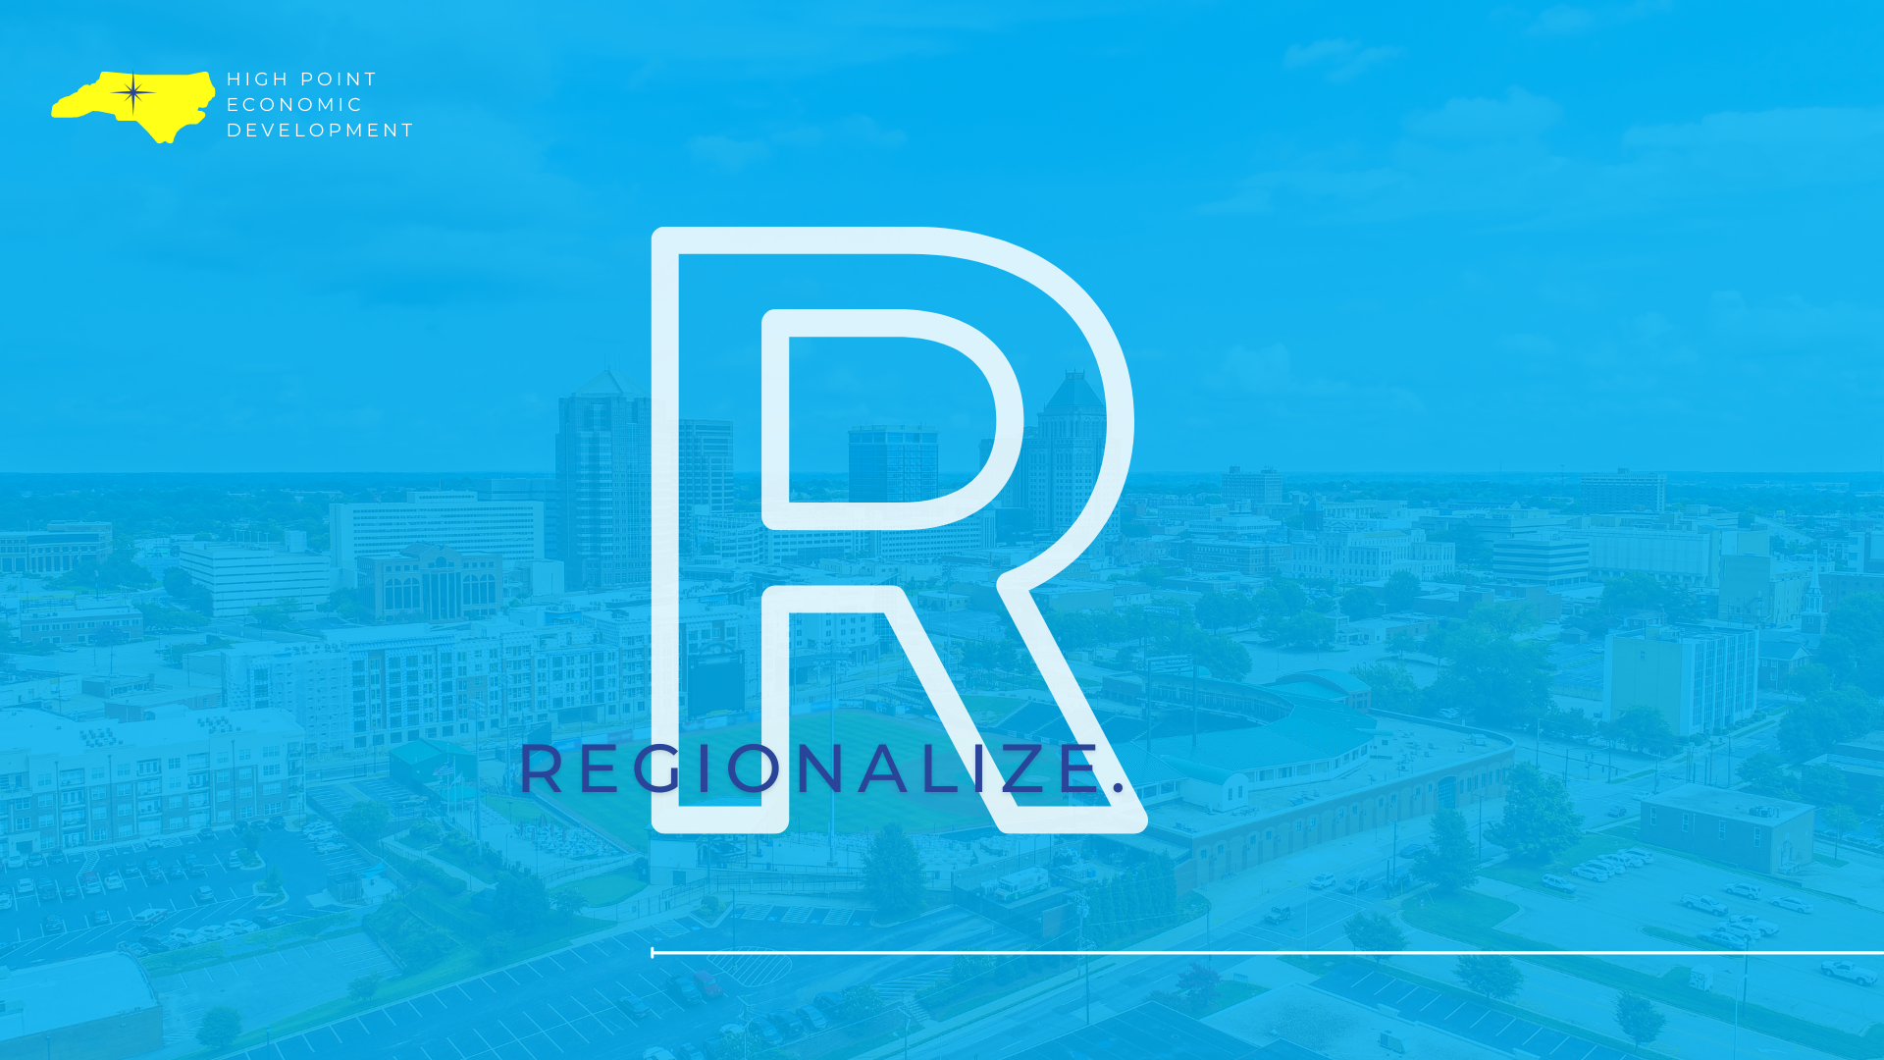

Slide 22
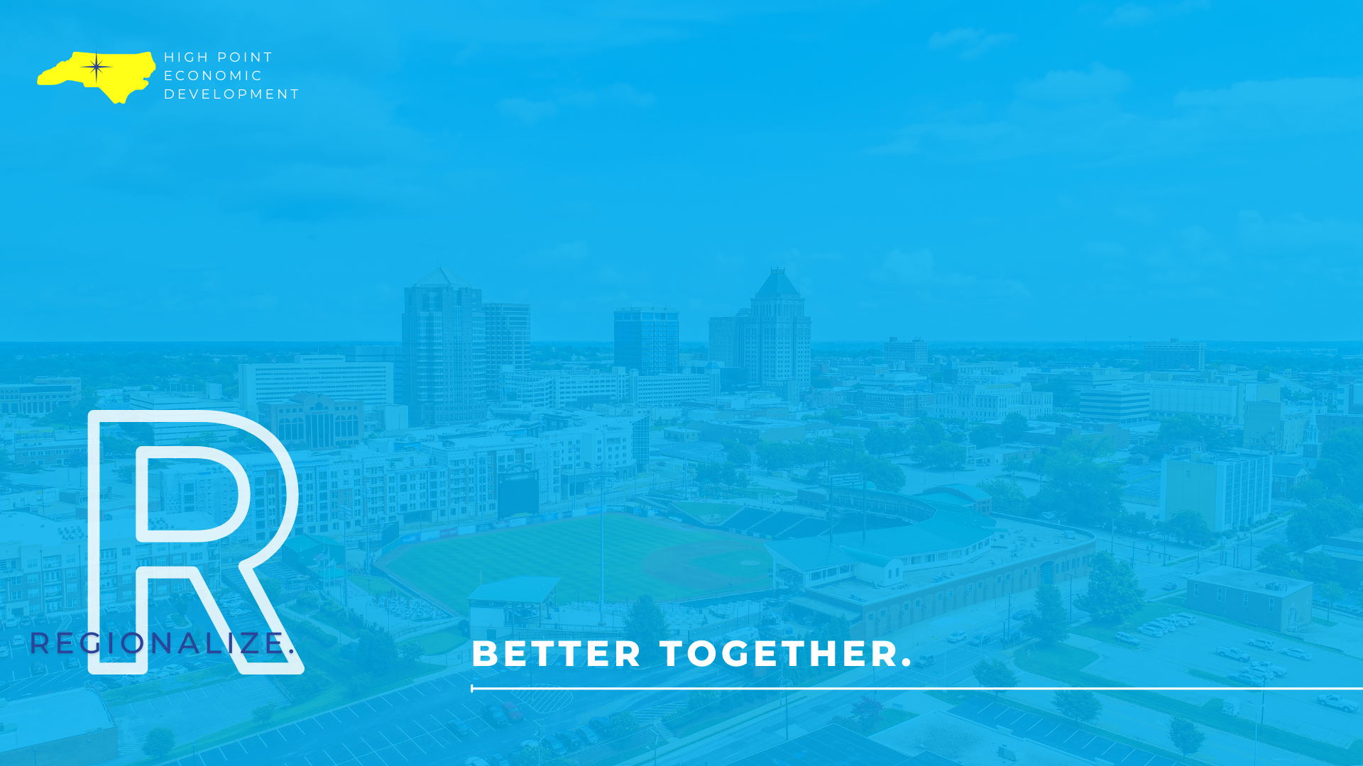

Slide 23


Slide 24
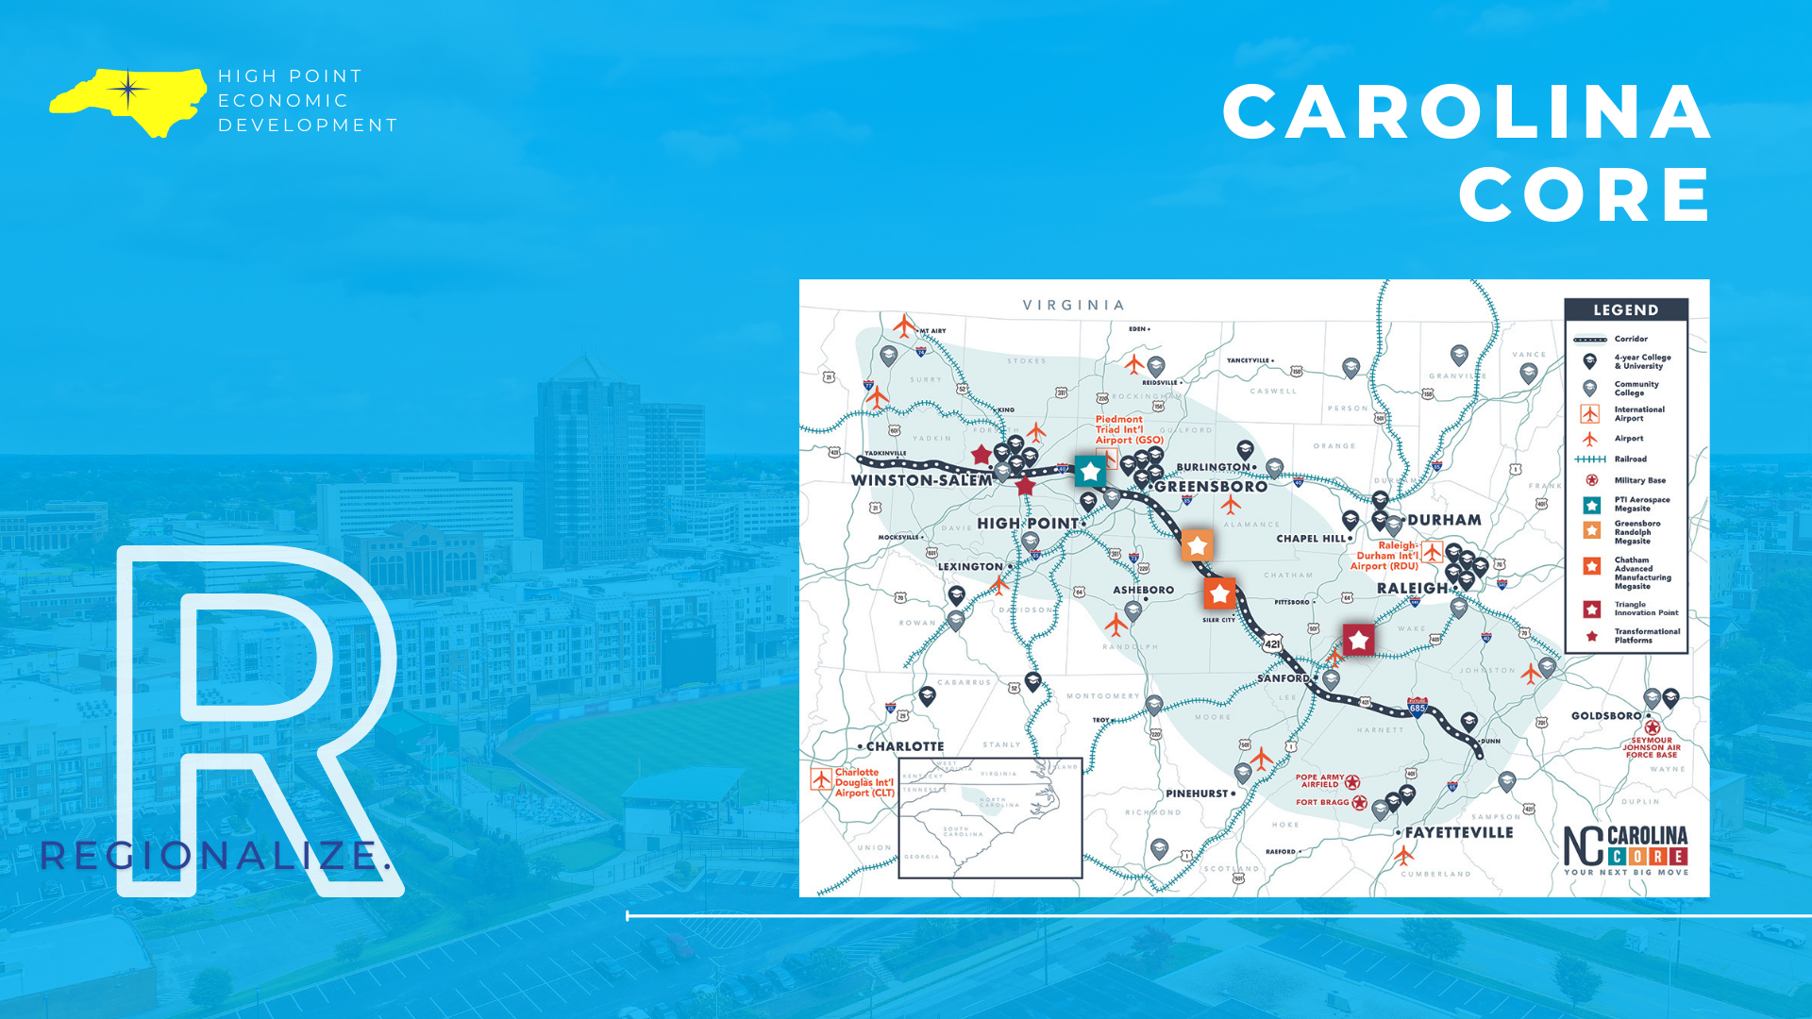

Slide 25
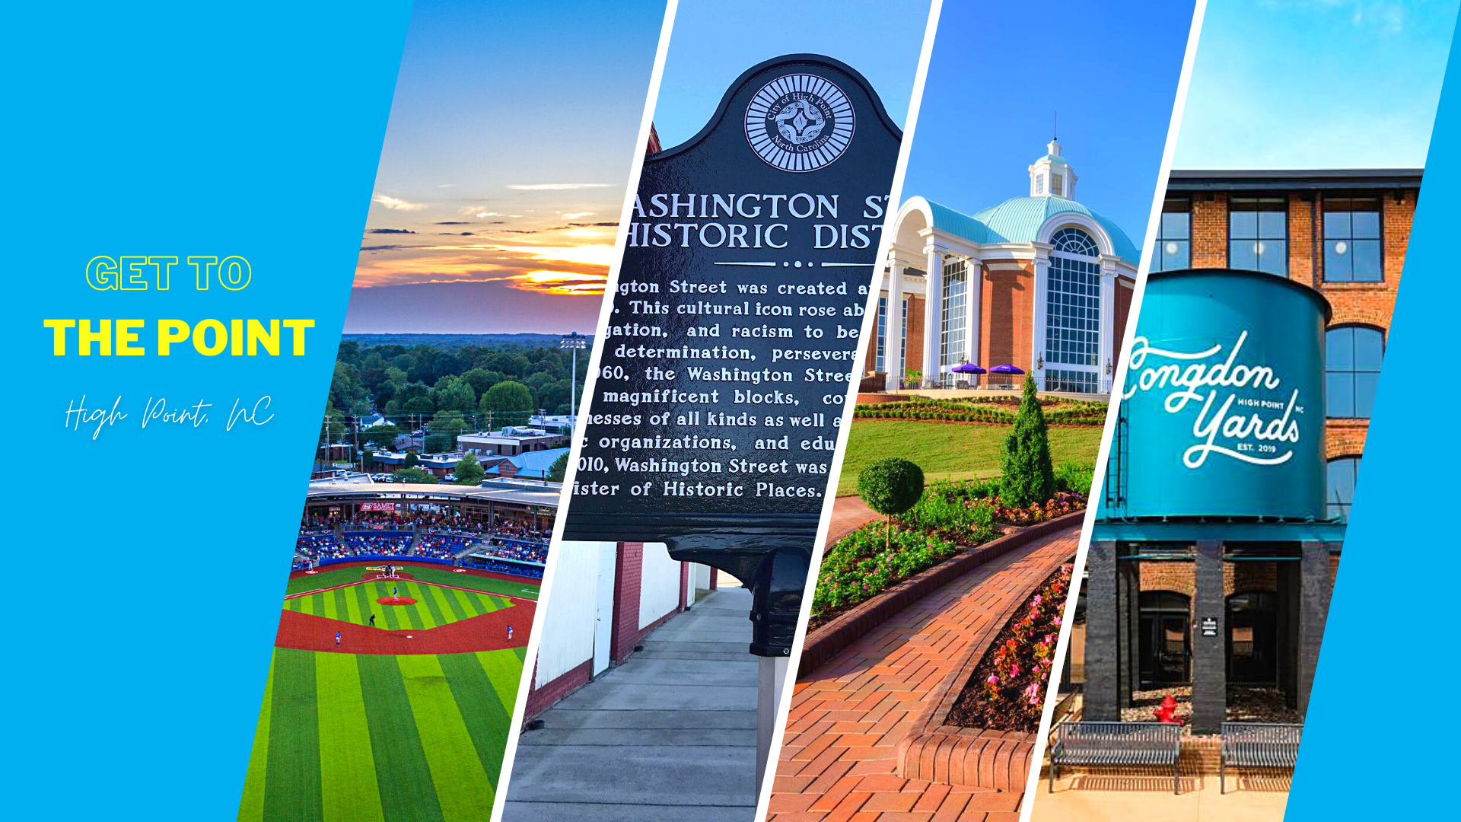

Slide 26


Slide 27
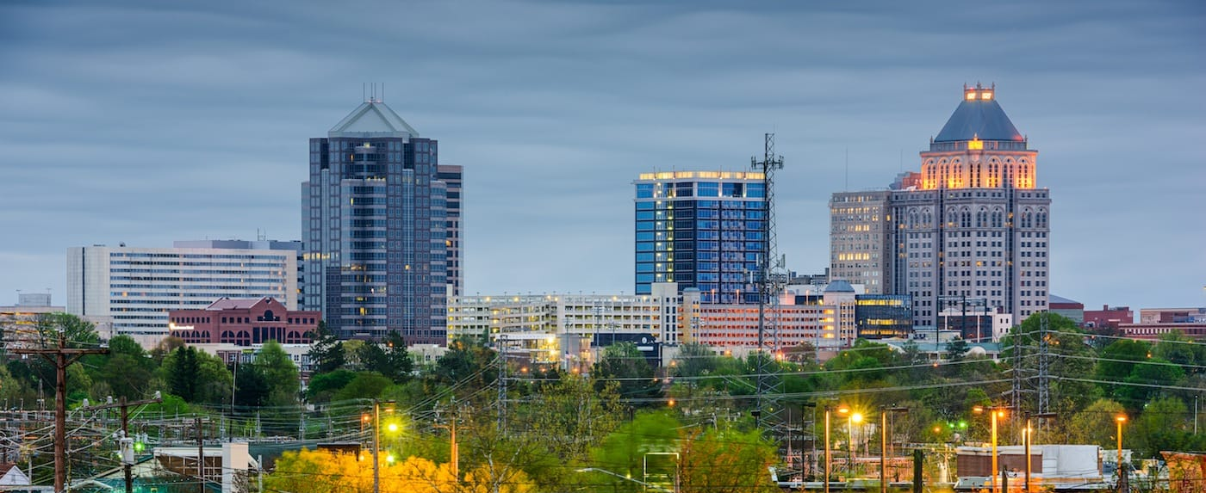
Economic Development Update

Slide 28
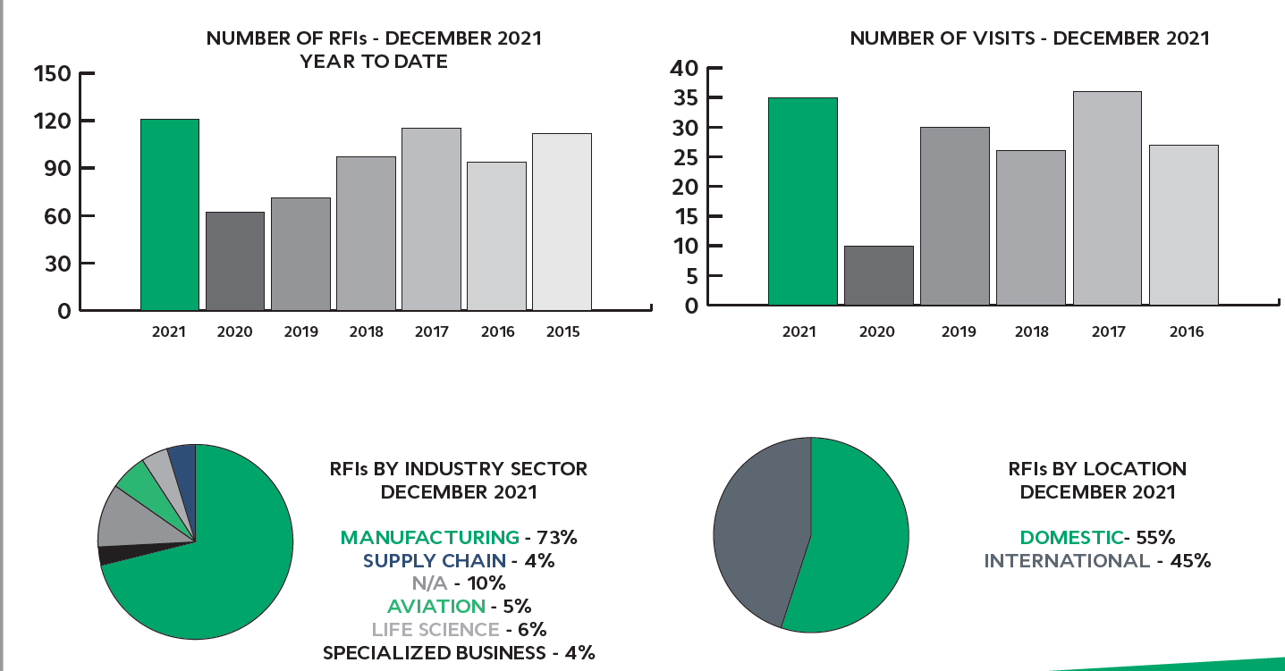

Slide 29
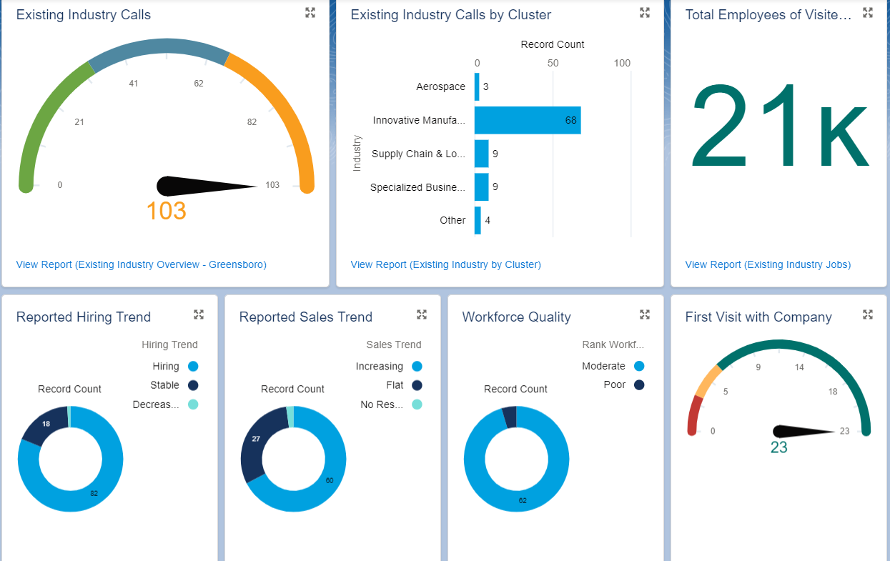

Slide 30



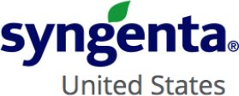
Jobs: 1,750
Capital Investment: $1.29 billion
Jobs: 116
Capital Investment: $57 million
Jobs: 50
Capital Investment: $6 million
Jobs: 650
Capital Investment: $68 million

Slide 31
Piedmont Commerce Center
Youngs Mill Industrial Center
I-73 Spec Building
Greensboro 40 Logistics Center

Slide 32
Norkolk Southern Land
Brittway II
Birch Creek Business Park
Burlington-Mackintosh Site

