Slide 1

People
Our Buildings Greatest Asset
March 10, 2022

Slide 2

Todays Discussion Topics
Components to Help Protect Occupants
Roadmap to Healthy Building Certification
Checklist to Improve Your Indoor Environments
Questions & Solutions

Slide 3
Roundtable Discussion

Slide 4
Roundtable Discussion
What percent of your occupants will return back to the office?
What is the number one safety/health request of occupants today?
Are you currently monitoring your indoor air in real time?
Will you continue your essential cleaning practices?
Have/will you look to achieve an 3rd party wellness certification for your building(s)?

Slide 5








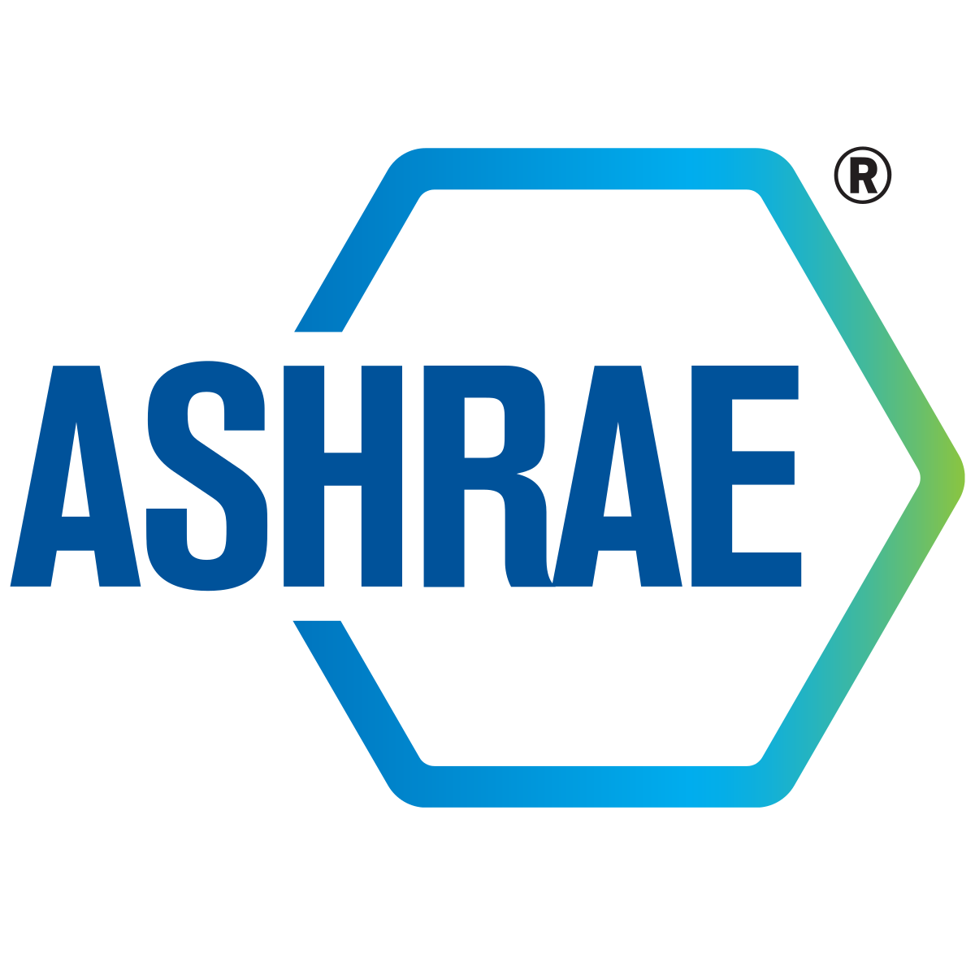





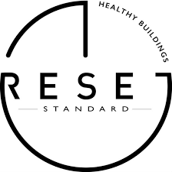




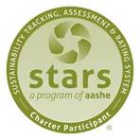






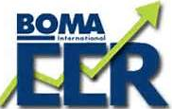





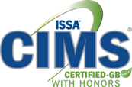


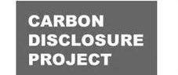
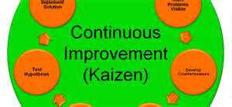
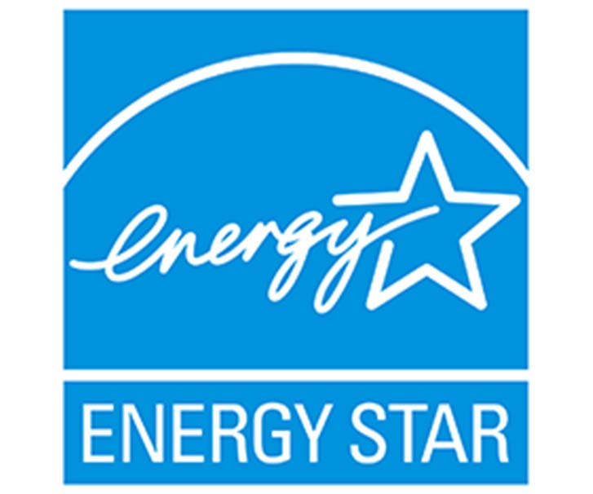
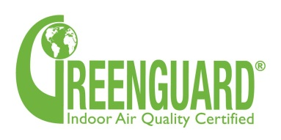
FM Standards in the Built Environment

Slide 6
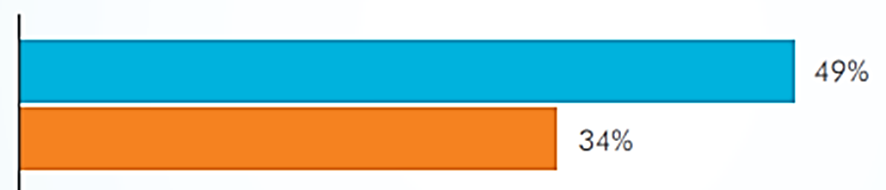

Wellness as a Criteria: Occupant Satisfaction
Strongly Favor Buildings with Enhanced Wellness Offerings
Preference for
Buildings with Conservation Ratings
Source: CBRE Americas Occupier Survey Report 2018
2014: Agents of the healthy workplace: The International WELL Building Institute and CBRE
The headquarters for CBRE, a global real estate brokerage and advisory firm, is a poster child for creative offices, as it’s not just an open space bathed in natural light that invites collaboration and socializing, it’s also healthy for its employees.

Slide 7
Wellness: The Built Environment Nexus
“Employers are facing an unwinnable scenario trying to convince employees that they care about employee well-being if they cannot provide any measure of assurance regarding IAQ in their buildings.” – Anonymous JLL Facilities Manager
“42% of employees cited fear of inadequate air quality and cleaning practices as the reason why they do not want to return to the workplace” - February 16, 2022 Pew Research
Cognitive functions suffer when exposed to elevated CO2 levels and VOC. ”Government regulations will increasingly descend upon the built environment similar to the NJ IAQ Standard requiring CO2 levels are monitored to maintain below 1,000 ppm while the facility is occupied”.
- Environmental Health Perspectives study
“Employers or building owners/operators will lose the high ground in an instant if occupants perceive that you are trading off their health with ROI. This issue isn’t confined to vulnerable groups such as babies, children and the elderly in buildings like schools and hotels” – Joseph Allen Harvard University

Slide 8
Components to Help
Protect Occupants

Slide 9
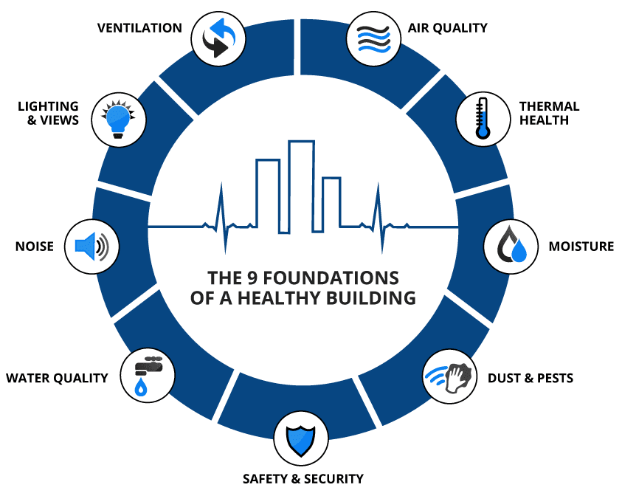
Components of “Healthy Buildings” for Occupants
Source: https://9foundations.forhealth.org

Slide 10
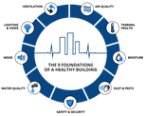
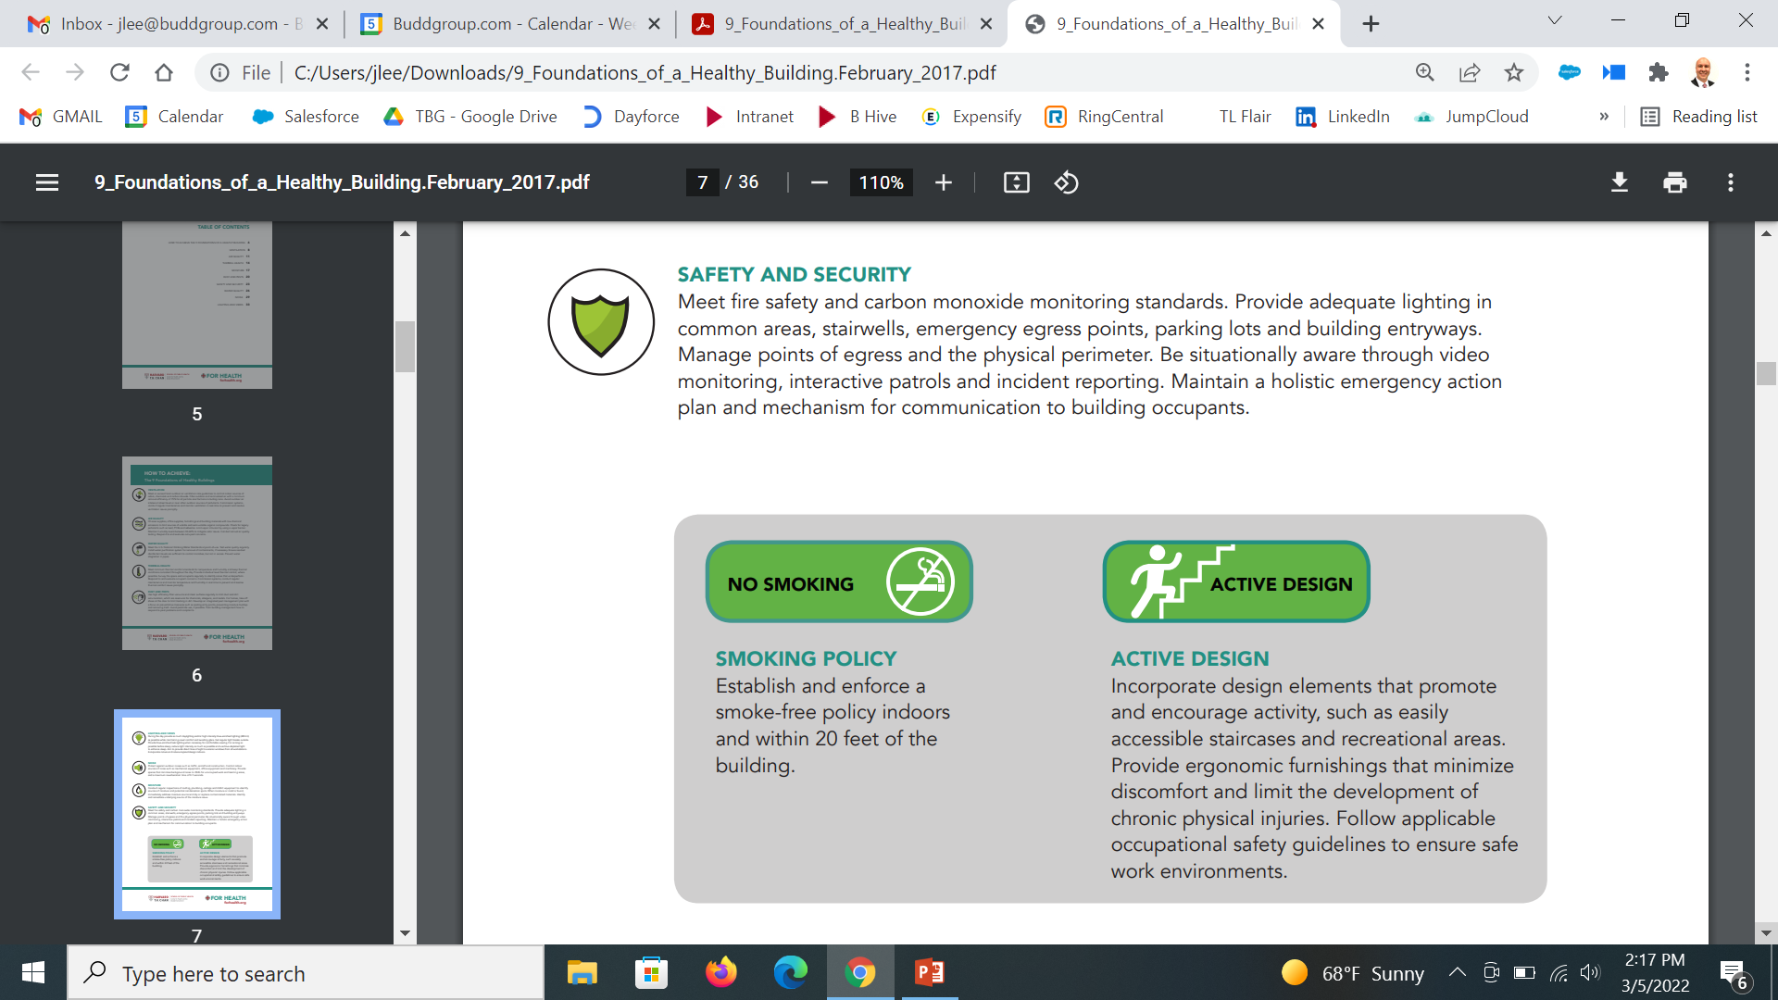
Foundations of a Healthy Building
Workplace health, safety, and security programs improve quality of life for your employees, but they also improve your business’s bottom line. Liberty Mutual Insurance maintains a public Workplace Safety Index, last updated in 2018, where they track injury trends. They found that nonfatal workplace injuries caused nearly $60 billion in direct U.S. worker compensation costs that year.
U.S. businesses lose over 1.4 billion work days of productivity every year due to “absence and impaired performance,” according to the Integrated Benefits Institute (IBI), which IBI estimates is roughly equivalent to $500 billion annually. Keeping your employees healthy and at work isn’t just the right thing to do, it can also drastically improve your bottom line.

Slide 11

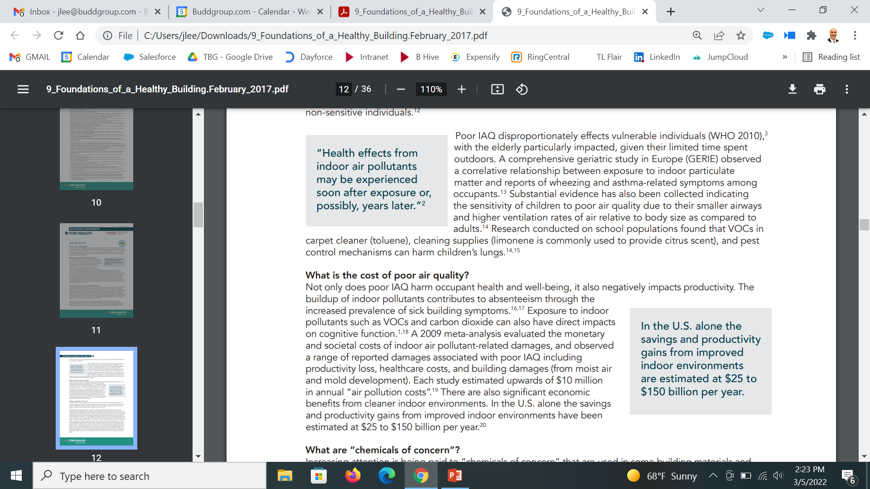
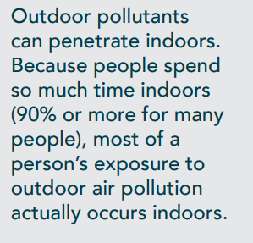
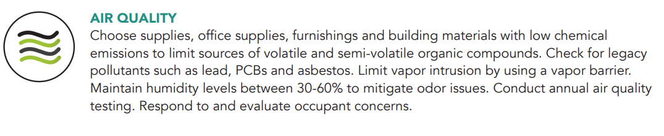
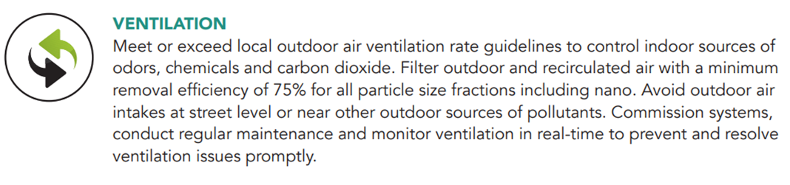
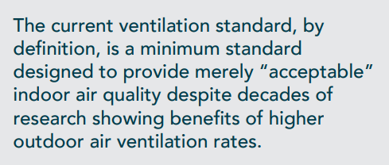
Foundations of a Healthy Building

Slide 12
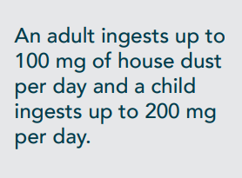
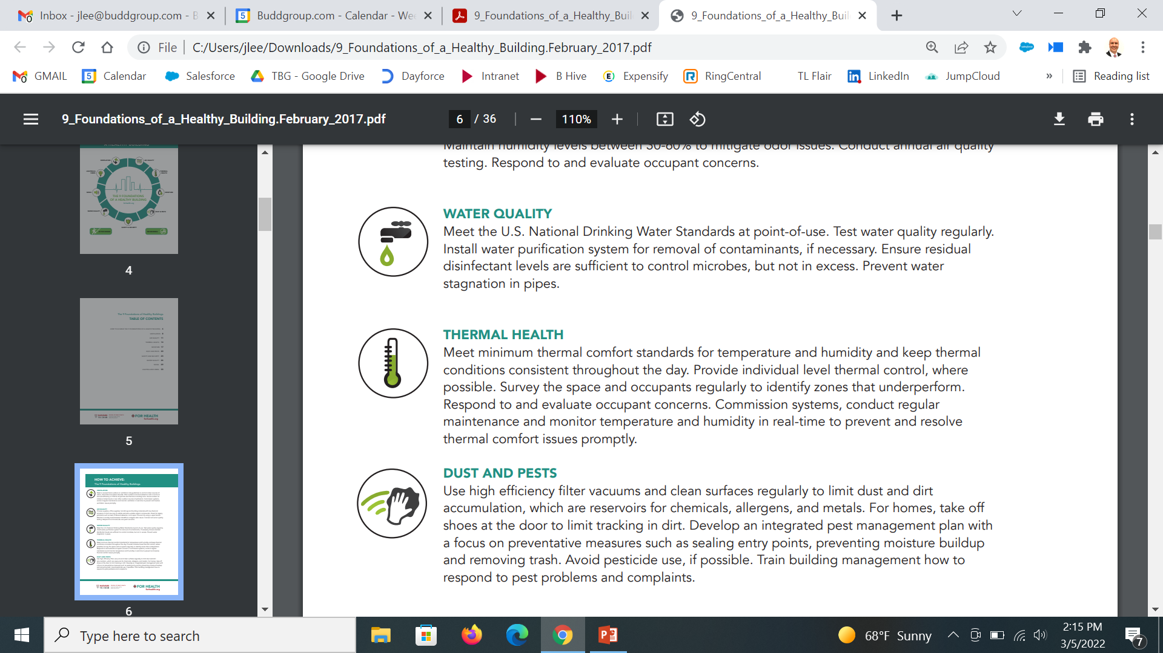
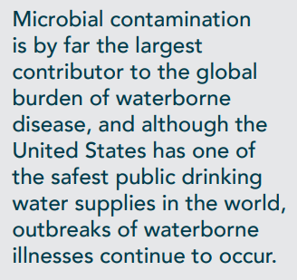
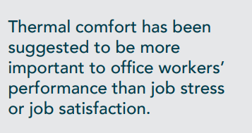
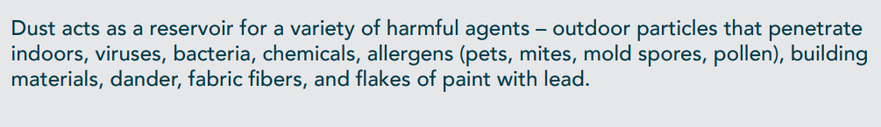
Foundations of a Healthy Building

Slide 13
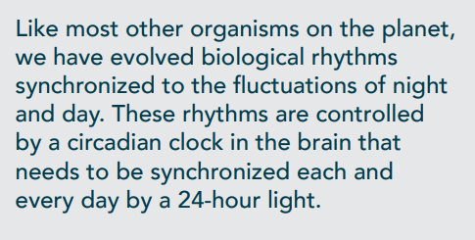
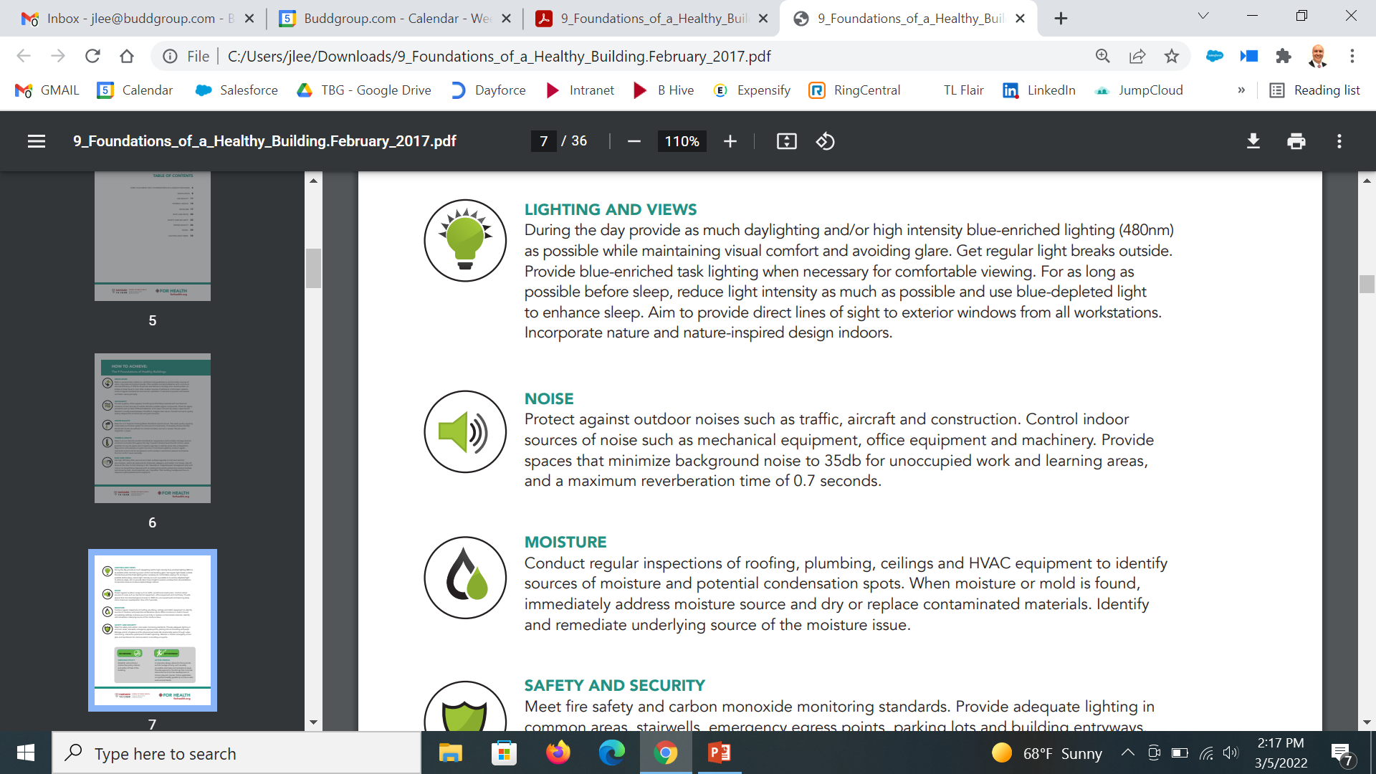
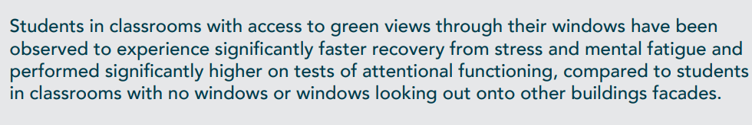
Foundations of a Healthy Building

Slide 14
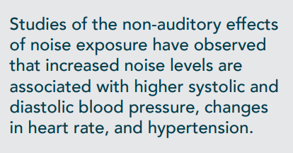
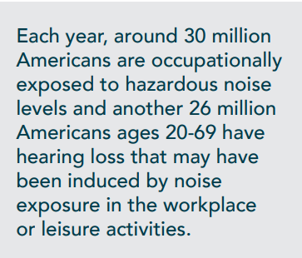
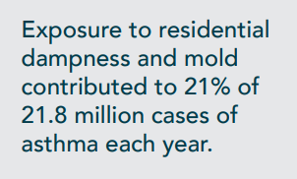
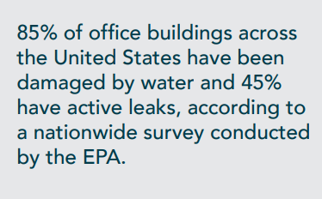
Foundations of a Healthy Building

Slide 15
Foundations of a Healthy Building

Slide 16
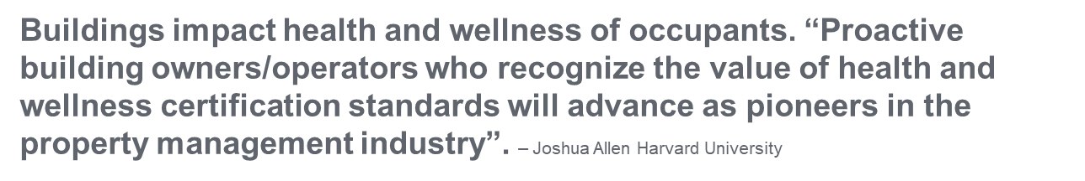
Roadmap to
Healthy Building Certification

Slide 17
Health & Wellness vs Efficiency
LEED focuses on reducing building footprint
while
the newest certifications such as WELL, Fitwel and RESET
are focused on
OCCUPANT health and wellness
.

Slide 18
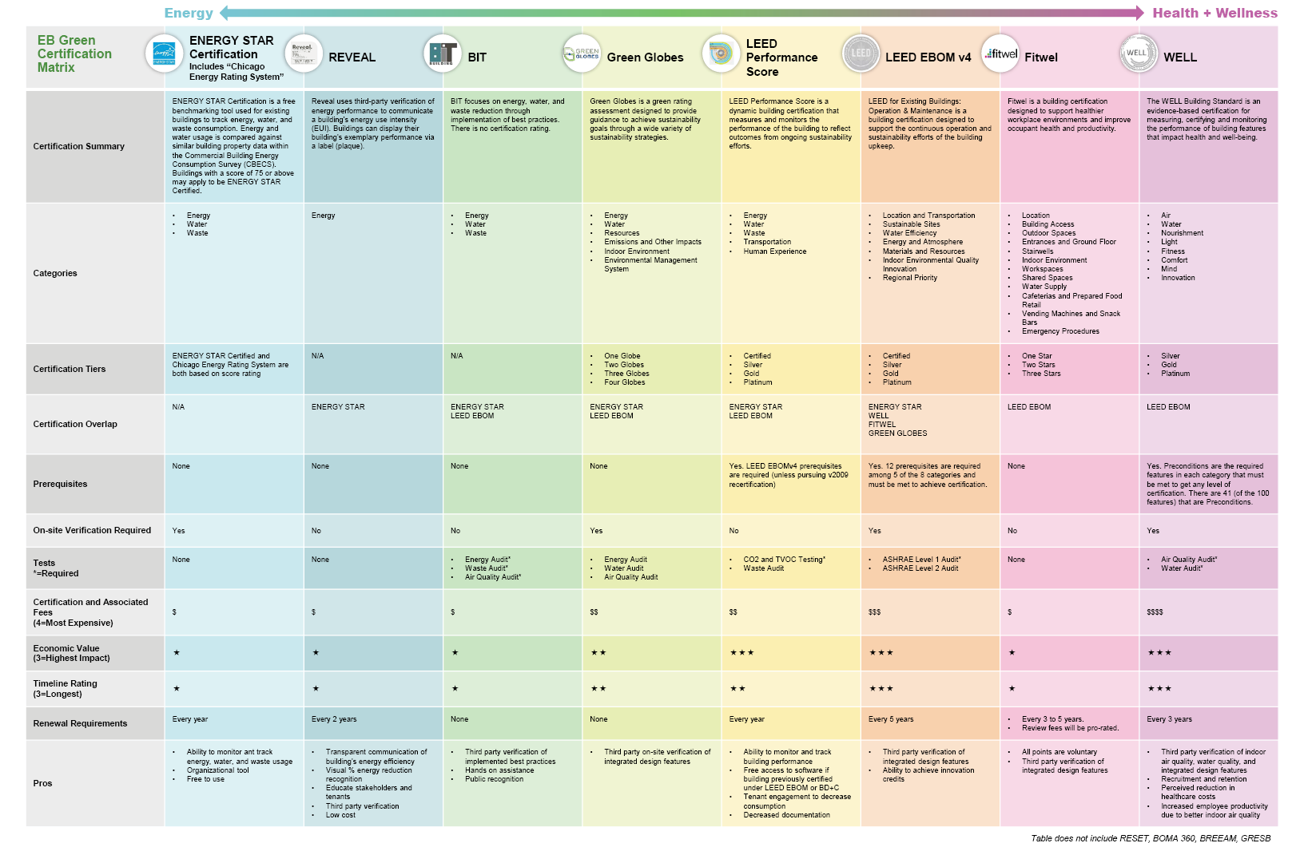
http://www.esdglobal.com/news/article/1201-guiding-you-through-the-busy-green-ratings-systems

Slide 19
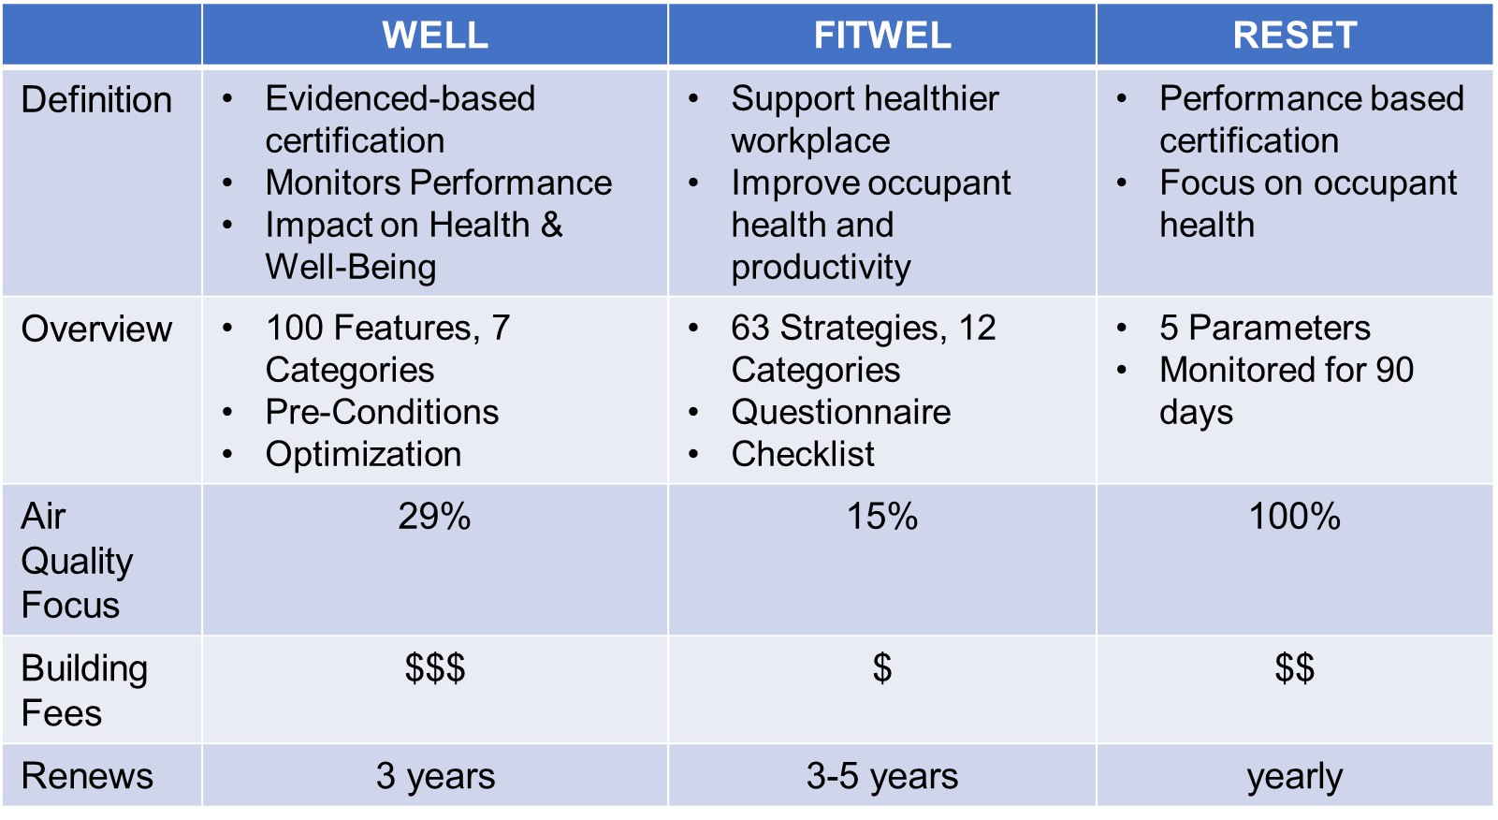
Various Building Health & Wellness Ratings
http://www.esdglobal.com/news/article/1162-what-s-the-buzz-making-sense-of-wellness-certifications

Slide 20
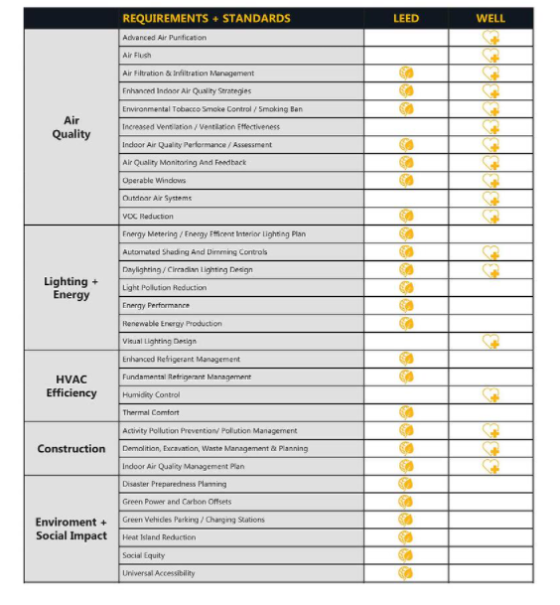
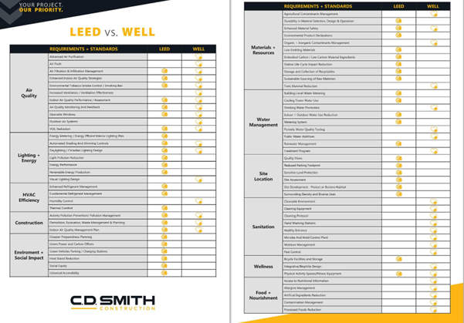
LEED & WELL Building Certification

Slide 21

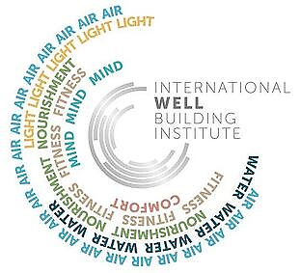

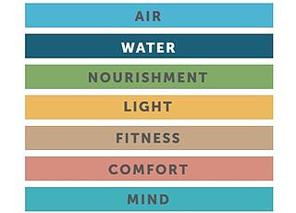
LEED & WELL Building Certification

Slide 22

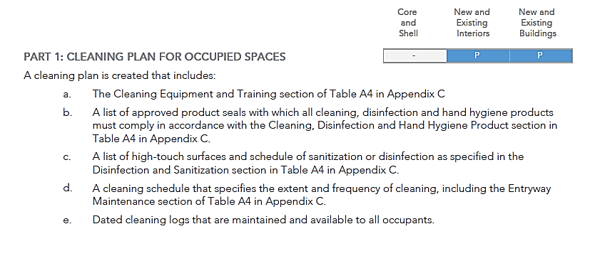
CLEANING PROTOCOL
CLEANING

Slide 23
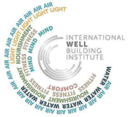
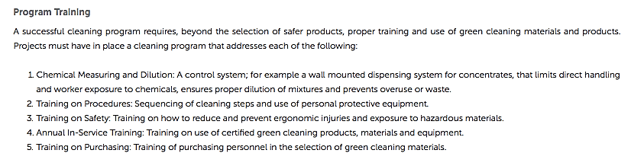
CUSTODIAL TRAINING
CLEANING

Slide 24
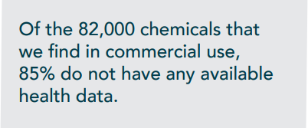

CLEANING PRODUCTS
CLEANING
Certified cleaning products eliminate harmful ingredient contents and reduce potential associated hazards.
Cleaning, disinfection, and sanitization products selected for use must be certified according to the criteria in Table A4 of the WELL Building Standard. These include product certifications such as:
  EPA’s Safer Choice
  GreenSeal
  Environmental Choice New Zealand
  EU Ecolabel
  Nordic Ecolabel, etc.
  For projects outside the United States, any Type 1 eco-labeling program as defined by ISO 14024: 1999 developed by a member of the Global Ecolabelling Network may be used.

Slide 25
CLEANING EQUIPMENT
CLEANING

Slide 26
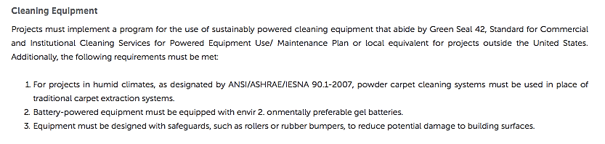
CLEANING EQUIPMENT
CLEANING

Slide 27
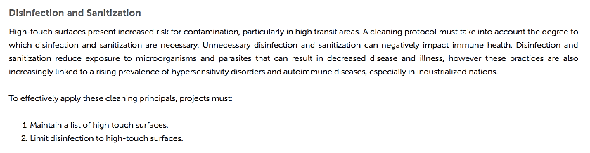
DISINFECTION/SANITIZATION
CLEANING

Slide 28
HIGH TOUCH SURFACES
THE FOLLOWING ARE CONSIDERED HIGH-TOUCH SURFACES AND REQUIRE MORE FREQUENT CLEANING THROUGHOUT THE WORK DAY:
CLEANING
Non-porous items:
Tabletops
Doorknobs
Elevator buttons
Telephones
Public digital devices
Light switches
Chairs
Bathroom handles/fixtures
Countertops in bathrooms
Toilet handles and lids
Bathtubs and shower walls
Kitchen handles and fixtures
Countertops in kitchens
Porous items:
Rugs
Upholstered furniture covers/Curtains

Slide 29
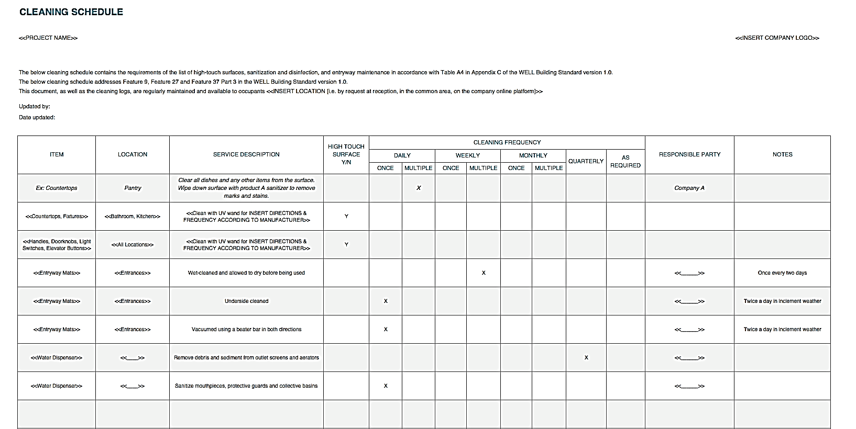
CLEANING SCHEDULE
CLEANING

Slide 30
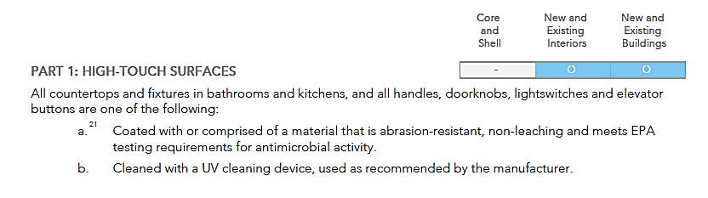
ANTIMICROBIAL ACTIVITY
CLEANING

Slide 31
HAND HYGIENE PRODUCTS
Certified cleaning products eliminate harmful ingredient contents and reduce potential associated hazards.
Hand soap and sanitizers selected for use must be certified according to the criteria in Table A4 of the WELL Building Standard. These include product certifications such as:
  EPA’s Safer Choice
  GreenSeal
  Environmental Choice New Zealand
  EU Ecolabel
  Nordic Ecolabel, etc.
  For projects outside the United States, any Type 1 eco-labeling program as defined by ISO 14024: 1999 developed by a member of the Global Ecolabelling Network may be used.
  Hand soaps and hand sanitizers should use no antimicrobial agents (other than as a preservative) except where required by health codes and other regulations (e.g., food service and health care requirements).
CLEANING

Slide 32
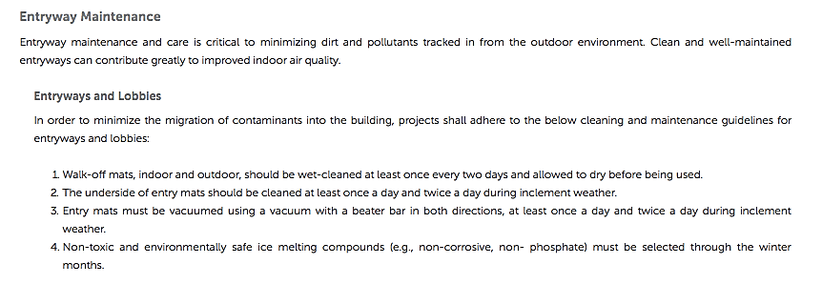
ENTRYWAYS
CLEANING

Slide 33
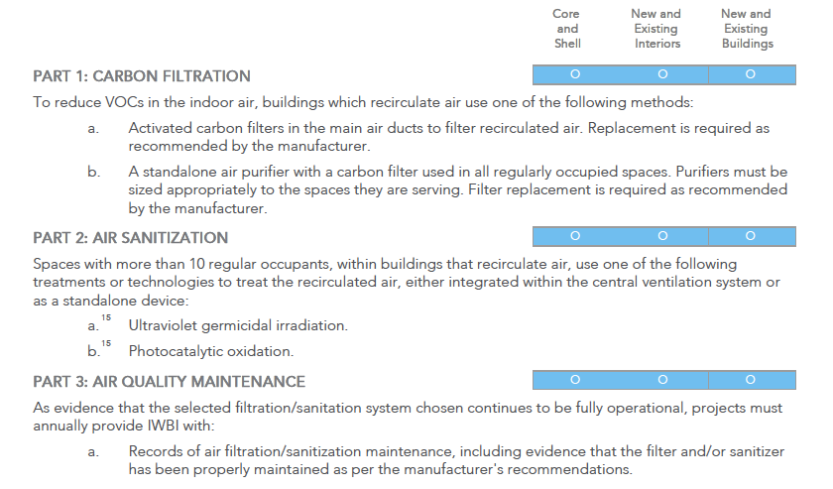
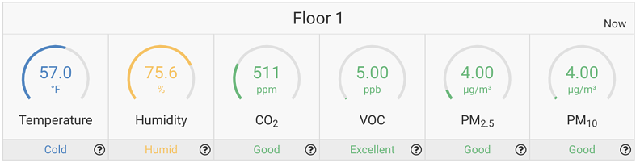
AIR PURIFICATION
MAINTENANCE

Slide 34
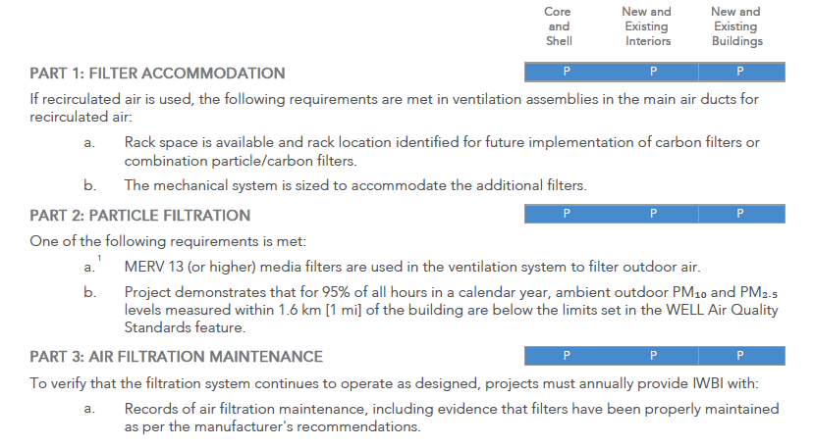
AIR FILTRATION
MAINTENANCE

Slide 35
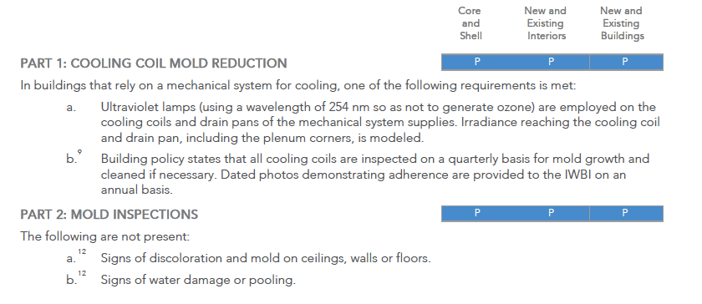
MICROBE & MOLD CONTROL
MAINTENANCE

Slide 36

PESTICIDE MANAGEMENT
MAINTENANCE

Slide 37

PEST CONTROL
MAINTENANCE

Slide 38

MOISTURE MANAGEMENT
MAINTENANCE

Slide 39

WATER QUALITY TESTING
MAINTENANCE

Slide 40
DRINKING WATER
MAINTENANCE

Slide 41
Checklist to
Improve Indoor Environment

Slide 42





Checklist: Improving Your Indoor Environment
“Creating safe microenvironments for all occupants”
A Customized Pre-cleaning Regimen
  Surface sanitization during normal work hours
High Touch Point Disinfection Systems
  Consisting of hospital grade products, tools equipment and processes
Antimicrobial Surface Treatments
  Provide residual efficacy of up to 90 days protection
Photocatalytic Air Purifier Technology
  Transforms any surface into a self cleaning air purifier
In-Room Air Purification Systems
  3 levels of protection = Odor control, antimicrobial and certified HEPA filtration
Indoor Air Quality Monitoring
  Real time monitoring of occupant air quality
Notes:
Holistic outline

Slide 43

Checklist: Improving Your Indoor Environment

Slide 44
Questions & Solutions
Jason Lee
Jlee@buddgroup.com
C# 336.231.3740

