Slide 1


Violence in the Workplace
Erin Weeks
Owner/Consultant

Slide 2

Goals
Understand why the discussion around violence in the workplace is important
Understand important terms
Identify several types of workplace violence
Understand how your role as an FM, Manager, or Employee can prevent or mitigate the impact of workplace violence
Understand and discuss technologies that can help in addressing violent or potentially violent situations
Understand how you can work to mitigate violent situation using policies, technology and planning
Learn from each other how we can best manage workplace violence situations

Slide 3
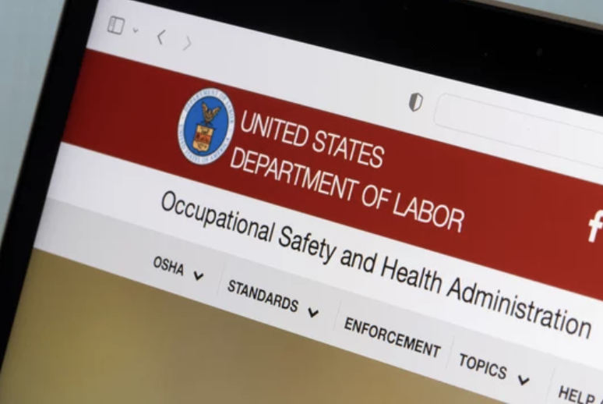


Why is this topic relevant/important?
Workplace violence is the 3rd leading cause of death in the workplace (OSHA)
About 2 million incidents a year nationally
  OSHA General Duty Clause
    “Each employer --shall furnish to each of his/her employees' employment and a place of employment which are free from recognized hazards that are causing or are likely to cause death or serious physical harm to his employees;”
  Business Reputation
  Employee recruitment and retention
  Customer perception

Slide 4
Defining Terms
Violence in the Workplace - any act or threat of physical violence, harassment, intimidation, or other threatening disruptive behavior that occurs at the work site. It ranges from threats and verbal abuse to physical assaults and even homicide. It can affect and involve employees, clients, customers and visitors.
Domestic Violence - a pattern of behavior in an intimate relationship that is used by one partner to gain or maintain power and control over another intimate partner. Domestic violence can use physical, sexual, emotional/psychological, financial, or technological actions or threats of actions or other patterns of coercive behavior in order to exert that control.

Slide 5



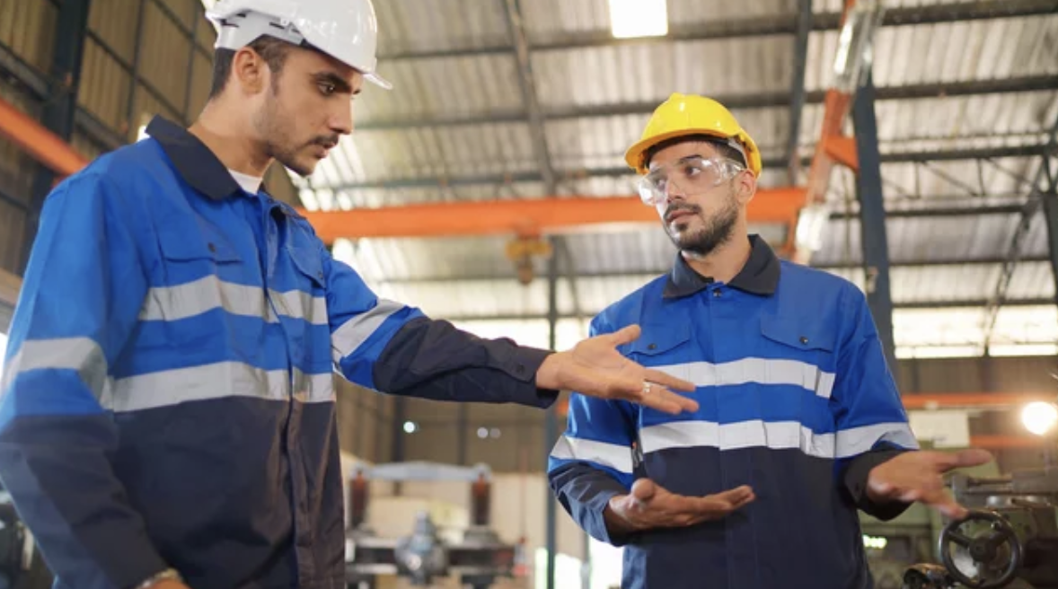
Types of Violence in the Workplace
Domestic Violence
  Can be from workplace relationships
  May be from outside relationships that show up at the workplace
  1 in 4 women and 1 in 7 men have been victims of severe physical violence (e.g. beating, burning, strangling) by an intimate partner.¹
  Victims of intimate partner violence lose a total of 8.0 million days of paid work each year.
  Between 2003 and 2008, 142 women were murdered in their workplace by their abuser, 78% of women killed in the workplace during this timeframe.
Problematic Terminations
Employee Conflict
Seemingly Random Acts of Violence – not usually as random as we think

Slide 6

What is your role?
Are you a Facility/Safety Manager?
  Create the safest environment possible
  Act on reports you receive
  Anticipate problems
  Create systems and policies to address those problems

Slide 7
What is your role?
Are you a fellow employee or a visitor at another person's place of work?
  Get yourself and others to safety should a situation arise
    A study of intimate partner homicides found that 20% of victims were not the intimate partners themselves, but family members, friends, neighbors, persons who intervened, law enforcement responders, or bystanders.
  Report problems immediately to proper personnel
  Pay attention to your surroundings and interactions around you
    Exits or other means of egress
    Fire extinguisher/AED location
    Do you see a situation escalating? What is your exit strategy?

Slide 8
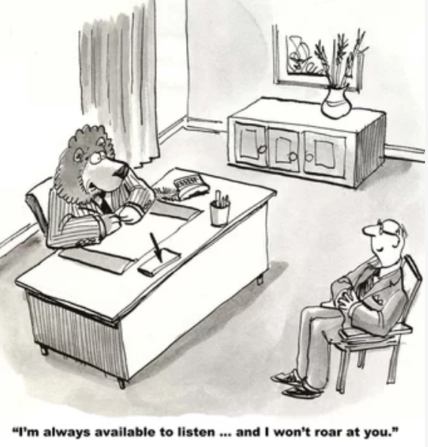
Getting Ahead of the Problem
Set up policies that encourage reporting of behavior that could escalate to violence
  Zero Tolerance Policy for any threatening or violent behavior against or by an employee.
Maintain an open-door policy with employees so they feel comfortable communicating issues with leadership
Provide resources in safe space like restrooms, posters, stickers on mirrors, etc.
Include training on these issues in existing safety training, employee handbooks, and SOP manuals

Slide 9
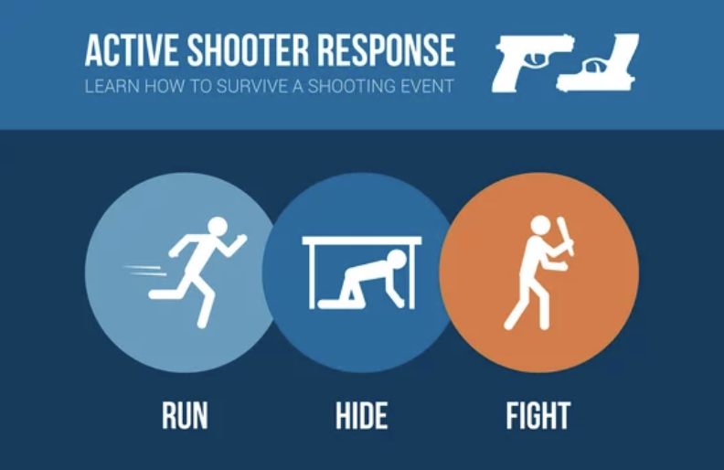

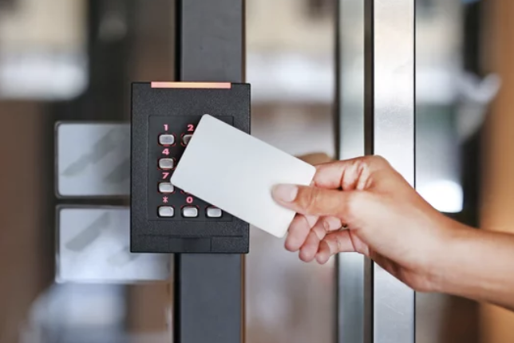
Getting Ahead of the Problem
Use technology to your advantage
  Camera Systems
    Facial Recognition Technology
    Do you have adequate camera coverage?
  Alarm Systems (Notification Systems)
    Do you have a system in place for discreet notification? (i.e. panic button)
    Do you have a Mass Notification System in place?
      Active Shooter
      Severe Weather
      Medical Emergency
  Access Control Systems
    Turn badge and camera access off immediately for terminations
    Use the systems appropriately (no propped doors – or set up system to alarm when this happens)
    Key Controls
  Lighting

Slide 10

What to do if the Unthinkable Happens
Encourage employees to report and log all incidents and threats of workplace violence
Provide medical evaluation and treatment after the incident
Report violent incidents to the local police
Inform victims of their legal right to prosecute perpetrators
Offer stress debriefing sessions and posttraumatic counseling services to help workers recover from a violent incident
Investigate all violent incidents and threats, monitor trends in violent incidents by type or circumstance, and institute corrective actions.
Determine if policies/procedures need to be updated based on what occurred
Communicate any changes to all staff

Slide 11

Discussion/Scenarios
Termination of volatile employee
Termination of senior manager
Relationship between two employees
Violence perpetrated by an outside party
What other types of scenarios have you encountered?

Slide 12
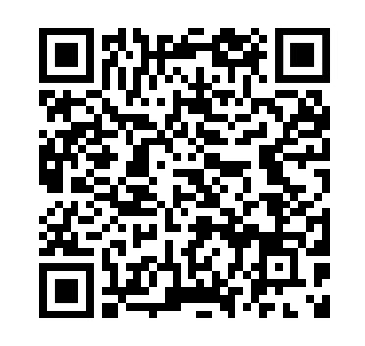
Additional Resources
OSHA guidance on Workplace Violence
  https://www.osha.gov/workplace-violence
  https://www.osha.gov/sites/default/files/publications/factsheet-workplace-violence.pdf
Domestic Violence Resources
  Domestic Violence National Hotline: www.thehotline.org
  Department of Justice: https://www.justice.gov/ovw/domestic-violence
Active Shooter Resources
  www.alicetraining.com
Mass Notification Systems
  https://www.dhs.gov/publication/mass-notification-systems
Link to Presentation

Slide 13

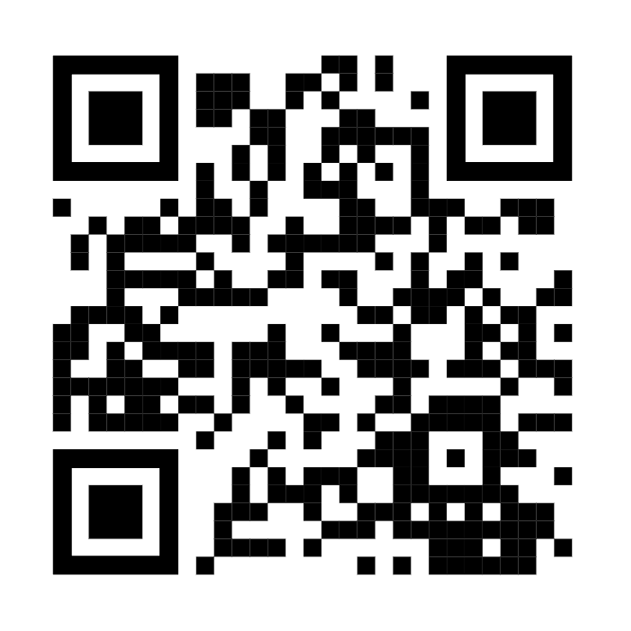

Thank you!
Facility Management Solutions
Maintenance and building engineering team guidance and support
Lighting improvement projects
Location and space scouting, lease negotiations and tenant improvement upfit guidance
Space planning
Vendor /contractor selections
Furniture, fixtures and equipment (FF&E) selection, planning and installations
Interim/start-up facility management
Computerized Maintenance Management System (CMMS) selection and implementation
Building condition assessment
Warehouse, Logistics and Supply Chain Solutions
Rack configurations, installation and relocation
Automation design and engineering
Robot / collaborative robot selection and implementations
Sortation equipment section and implementation
Autonomous Maneuverable Robots (AMRs)
Process improvements
Project management
Manufacturing Solutions
Facilities management support and planning
Project management
Lean Six Sigma Process improvement
Capital planning
Factory and site acceptance testing of equipment
EHS support
Erin Weeks
erin@profmsolutions.com
www.profmsolutions.com
Coming Soon!

